Slide 1
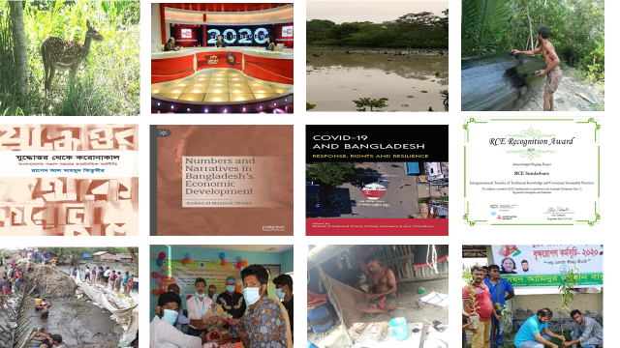
UNNAYAN ONNESHAN Annual Report 2020-2021
Advancing Ideas and Building Constituencies for Social Transformation

Slide 2
Contents
Message from the Chairperson 03
About Unnayan Onneshan 06
July 2020 12
August 2020 18
September 2020 23
October 2020 28
November 2020 32
December 2020 37
January 2021 41
February 2021 45
March 2021 49
April 2021 53
May 2021 57
June 2021 62
UO Book Series 67
Organisational Development 70
Membership and Partnership 73
REC Recognition Award 76
UO Trustees & Family 77 Summary of Financial Statement 87

Slide 3
Message from the Chairperson

Slide 4
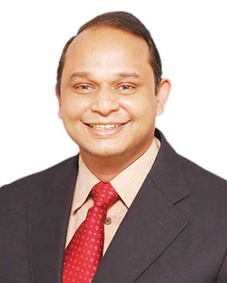
At a time when Bangladesh is about to celebrate its 50 years of independence, the Covid-19 pandemic is hitting people's lives and livelihoods with great uncertainty. This is the first time in the last 30 years that the poverty rate has risen due to the pandemic. Many people have become unemployed. Inequality has increased. The government has already launched nationwide vaccination programmes and announced debt-based incentives to deal with the impact. Experience from around the world, however has shown that debt-based incentives alone do not work. Often powerful clientelistic syndicate grabs the debt-based incentive and the majority of the people become deprived. Thus the rich get richer, the poor get poorer. An equitable recovery requires reducing new poverty and inequality through quality public spending, creating jobs, increasing skills, and ensuring the socio-economic rights of every citizen. Against this backdrop, this pandemic call for new set of thinking and actions.
It is my immense pleasure to thank every member of the Unnayan Onneshan (UO) for their incessant and countless efforts throughout the year. Our national and international partners have been with us throughout the journey with optimum support and solidarity. I would like to acknowledge the dedication of the members of the Board of Trustees.
The year 2020-21 has been afflicted with the second wave of COVID-19 pandemic. The fragile state of the global health sector has become more visible. Marginalized sections of the society — especially women, children, the elderly, the unemployed, the extremely poor, the informal sector workers, the lower-middle class and the middle class have been the most negatively affected. Since the onslaught of the pandemic, UO been making attempts to make highest possible use of the unprecedented predicament. The organization has continued making rigorous research works, arranging webinar discussions and paperworks on the implications of COVID-19 and recovery and reconstruction pathways of the economy from this pandemic.
In the face of ongoing crisis, UO has been exploring the road to equitable and sustainable recovery as well as transformation of the economy. It has come up with a new and integrated monetary and fiscal policy framework which has been appreciated in the policy level. It has been advocating for a new dimension of “basic income grants” for the poor ones which also has gathered great deal of attention. UO believes that without providing a comprehensive and universal social security programme an equitable recovery cannot be achieved. In addition, UO has been calling for a modified one health framework for post 2020 period, which can promote human transition into living in harmony with nature. The framework calls for ensuring rights-oriented universal social entitlements, provision of livelihood security and promotion of human-nature cooperation through green production, ecosystem-based approach and biodiverse adaptation to climate change, underwritten by customary sustainable practices and traditional knowledge. Thanks to the research team and all other partners. Their efforts and continuous support have made the research possible through this time in spite of manifold barriers and constraints.
In light of our core values, we have been working with optimum importance to improve the quality of our research and investigation by nurturing the penchant to explore things in multi-dimensional ways. Our effort in the year 2020-21 has enabled us to concentrate on rigorous and robust research. We have been engaged in action research on the ground to build models at the grassroots as well that could provide innovative solution to the pressing development problems that people and community face due to the impact of climate change and increasing natural disasters.
Throughout the year, UO has continued its efforts to build capacity and train young researchers for creating substantial pool of researchers in manifold aspects who are currently working with diligence and efficiency to produce innovative research. A good number of researchers have joined public and private universities as faculties. Many are working in development organizations and are contributing to innovation and knowledge generation.
UO’s path-breaking publications have steered public debates, demystified policies and provided robust and rigorous analyses for evidence-based policymaking. The organization has always actively put ideas directly to decision-makers at national and international levels as members of different national and international committees and members of official delegations in different negotiations.
The Economic Policy Unit through its flagship monthly reports on the vexing issues of the economy has demystified the puzzles, generated provocative ideas, reframed the debates, or provided new ways of looking at persistent problems. The Unit has focused, amongst others, on implication of non- economic factors on macroeconomic performance, budgetary implications, monetary policy, growth, inflation, liquidity crisis, debt and deficit, remittance, capital market, tax, food price and food security.
The Climate Change, Bio-diversity & DRR Unit has marveled by engaging in building implementable innovative models on the ground through multi-level partnerships promoting regenerative agriculture and sustainable livelihoods for vulnerable ecosystems and community based management of Sundarbans. The members of the unit have been dealing with climate change and sustainability, traditional and customary knowledge, rules and beliefs practiced by the traditional resource users that are congenial for the conservation of the natural resources of the Sundarbans.
The Social Policy Unit has also been working to advance innovative thinking relating to universal coverage in social sectors for accelerating the wellbeing of the citizen. The core of the research is to explore the necessity of remaking a citizen state based on the three pillars of independence of 1971— equity, human dignity and social justice. The major research scope includes education, health, poverty and social security, gender equality and women right etc.

Slide 5
This year Forest People Programme (FPP) has renewed the partnership with UO. UO has become able to maintain the active collaboration with organisations such as International Union for Conservation of Nature (IUCN), International Partnership of the Satoyama Initiative (IPSI), United Nations University Institute for the Advanced Study of Sustainability (UNU-IAS). It has also become a member of coordinating committee in Asia-Pacific Regional Centers of Expertise (AP-RCE) on Education and Sustainable Development. The RCE Sundarbans, hosted by UO, brings together leading universities and research organisations of Bangladesh to work with communities in the Sundarbans ecological critical area (ECA) through the multiple evidence base (MEB) as an approach that proposes parallels whereby indigenous and local as well as scientific knowledge systems are viewed to generate new insights and innovations through complementarities. The RCE Sundarbans has received RCE Recognition Award 2020 for acknowledged flagship project titled “Intergenerational Transfer of Traditional Knowledge and Customary Sustainable Practices by Regional Centre of Expertise on Education for Sustainable Development (RCE). It also participated number of international and national webinar throughout the year.
UO keeps working to publish a book series which consists of five volumes. The volumes will be on “New Theory and Evidence on Development : The Case of Bangladesh”, “Fiscal and Monetary Policies in Developing Countries: State, Citizenship and Transformation”, “Public Good and Public society: An Exploration in to Social Policies in Bangladesh”, “Transition and Transformation: In Quest of Expansion of Productive Capacity through Capital, Labour and Technology in Bangladesh”, “Wellbeing of Nature: An Examination into Natural Resource, Biodiversity and Climate Change in Bangladesh” and “Agrarian Transition: Land Transactions and Accumulation in Bangladesh”.
This year UO has been working to publish another four books. The first one, “Numbers and Narratives in Bangladesh’s Economic Devolopment” has been published by Palgrave macmillan, addressing the numbers and narratives that help analyze the necessary and sufficient conditions of the development of Bangladesh’s economy. The second one, The Sundarbans: Traditional Knowledge, Customary Sustainable Use and Community Based Innovation, makes an investigation into the traditional and customary knowledge, rules and beliefs practiced by the Traditional Resource Users (TRUs) that are congenial for the conservation of the natural resources of the Sundarbans. It attempts to contemplate the traditional practices of TRUs of the Sundarbans of Bangladesh part and identifies the contributions of traditional practices in the sustainable usage of natural resources. The third one in Bengali, “Bangladesher Ponchash Bochorer Rajnoitik Orthoniti” (From Independence to COVID-19 The Political Economy of Fifty Years of Bangladesh) have got published by Prothoma Prokashon which is an extended version of the “Political Settlement and Economic Outcome” published last year and includes a new chapter regarding COVID-19 and provides recovery path of the economy from the ongoing pandemic based on new principles. The fourth one, “The COVID-19 and Bangladesh: Response, Rights & Resilience” is a publication conceptualised by the Humanitarian and Development Research Initiative (HADRI), Western Sydney University, Australia, and the Unnayan Onneshan, Bangladesh and has been published by the University Press Limited Bangladesh. This one endeavours to provide an insight into the diversity of Bangladesh’s experience of the COVID-19 pandemic, specifically how different populations within Bangladesh have had to adapt to the public health crisis since the pandemic.
I would like to reiterate my gratitude to all of our members and partners, who have been comrading with us throughout our journey with their incessant dynamism along with devotion in a full rhythm. The success of 2020-21 has made us incumbent with more responsibilities to work hard and make innovative research work to put a resilient sign of multi-faceted dedication in the upcoming year. Moreover, we will try our best to amend the mistake and deficiencies which we could not do due to limitation of time and some unavoidable reasons.
I believe and hope that the upcoming year brings plenty of possibilities and innovations through relentless efforts. A strong rendezvous of dynamic issues will be made on a strong foundation of research field. I also hope UO will be more resilient in 2021-22 and contribute more in its respective research wings to make fruitful outcome, especially in the context of wavering economy of Bangladesh. Your continuous support and camaraderie is our strength which is worth appreciating once again.
Rashed Al Mahmud Titumir

Slide 6
About Unnayan Onneshan
A Centre for Research and Action on Development

Slide 7
The Unnayan Onneshan undertakes policy research for advancing ideas and building constituencies for social progression and provides technical assistance and capacity building services to local, national, regional and international organisations and levels. The Institute advances critical scholarship, promotes innovative solutions, and amplifies grassroots perspectives. The organisation works in collaboration with local and national partners, international organisations and leading universities.
The Research Division, divided into three units – Economic Policy, Social Policy, and Ecology and Environment Unit – brings flagship publications such as monthly economic update, annual state of economy and development, and four annual research based status reports on poverty, food security, women and labour. The nine research programmes deal with issues like governance, poverty, growth, equity, human rights, trade, agriculture, rights and participation, women rights and gender equality, education and health.
The Programme Management and Development Division provides advisory services, technical assistance and capacity building to the government and local, national, international, bilateral and multilateral organisations, ranging from likes of trade-related research and capacity building services to the government to technical assistance to local organisations to help farmers adopt to the climate change, to help indigenous communities to form collectives in sustainable use of biodiversity and eco-system services, to mange multi-partnership processes in addressing poverty, gender inequality and governance deficits, and to claim rights and held government agencies accountable to people.
The Unnayan Onneshan was registered in Bangladesh in 2003 as a not-for-profit Trust to contribute towards search for solutions to endemic poverty, injustice, gender inequality and environmental degradation at the local, national and global levels. The philosophy, ideas and actions of the organisation focus on pluralistic, participatory and sustainable development.
MISSION
The mission is to champion innovation for exploring paths of transformation towards a world, free from poverty, injustice, gender inequality and environmental degradation.
VISION
An egalitarian world free from all forms of inequality, injustices, discrimination and exploitation
CONCEPTUAL APPROACH
Since the organization's aim is to search for alternative paths of social transformation, it conceptualizes paradigm of development as of social transformation and change. Therefore, the unit is society, which according to us, is an inter woven system consisting of economic, political and social sub-systems, intertwined at every sphere–local, national and global. The societal sub-system entails configuration of classes, which interact with each other in political arena in order to retain control over productive resources in the economic sphere.
The political sub-system is the reflection of societal sub-system as the dominant class attempts to arrive at or impose a set of collective goals. The economic sub-system actualized goals through the production of goods and services. Likewise, environment disproportionately suffers from mere financialisation of nature. In other words, the societal sub-system defines players, the political sub-system inscribes rules and economic sub-system actualizes the system of accumulation.

Slide 8
STRATEGIC APPROACH
The organisation has opted for a 4-S strategic approach, combining three hands of critical scholarship, shared learning and social transformation, with sustainability at the center. The approach evolves from grassroots to link to local-national and international entities and maintains a circular flow. Both research and technical assistance are influenced by the principle of growth having rights, equality, justice sustainability and partnership for development through historic responsibility.
Critical Scholarship
The UO strongly believes that research and solution contribute to achieving sustainability, but these do not lead to bring in social transformation. The organisation builds critical scholarship through rigorous research underpinned on robust science.
The Unnayan Onneshan has adopted an optimistic view on role of knowledge in country’s journey towards development wherein the empowered citizens enjoy their rights equally. The organisation involves much of its energy in innovating approaches where sustainability is central. Building empirical model with full and effective participation of stakeholders concerned is a strategy of knowledge development and dissemination wherein best practices are up -scaled based on local politico-economic dynamics.
The UO examines every issue critically to explore underlying causes as well as to build knowledge base for future. Sustainability is a longitudinal process. Evidence based action research leading to model building for practical demonstration is one of the major tools used by the UO for developing and sustaining new knowledge. The organisation also comes up with thought-provoking research for mainstreaming principles of rights, equality and justice that results in improved wellbeing in the society and collectively contributes towards social transformation, which upholds a sustainability regime.
Shared Learning
Unnayan Onneshan deems learning as the core to sustainability based on the understanding that through learning actors assimilate information and update their cognitions and behavior. The Unnayan Onneshan works in collaboration with other organisations, forms partnerships, participates in events and act as a bridging organisation between local, national and international organisations which promote learning systems and facilitates the development of better theories and empirically testable models of learning for sustainability.
Social Transformation
Putting sustainability into practice requires knowledge about interactions among society, economy, politics and environment. Orthodoxy segregates operation of different interconnected spheres, which forge compartmentalised understanding on sustainability and puts obstacles towards social transformation. Unnayan Onneshan acknowledges that gap remains both in knowledge and practices and therefore research for sustainability demands cross and multidisciplinary cooperation on different levels of social sciences as well as between social and natural sciences. The Unnayan Onneshan transcends the disciplinary boundaries. Truly, sustainability presents many challenges, but creates many opportunities as well for research and knowledge generation.

Slide 9
CORE VALUES
The Unnayan Onneshan believes that a defined value system contributes to the culture and ultimate success of the organisation. The organisation, therefore, has developed its own value system and is persistently following in its activities
Value | What does the value mean?
Editorial Independence | The Unnayan Onneshan centres on the integrity of having editorial independence. The organisation’s research, public affairs and policy advice are built on knowledge, evidence and rigour, irrespective of individual’s choice, ideology, funding, or political persuasions.
High Quality | Quality is the key to UO’s working approach. The organisation endeavors to ensure, innovative approaches and best practices in its research, policy advice and public affairs.
Fairness, Diversity & Equality | The UO is committed to fairness, diversity and equality. The organisation works for raising voice of the unheard. The organisation has mainstreaming inclusionary principles in work, human resource and organisational development.
Working Together | The organisation works in collaboration with multiple partners ranging from community organisation to government and international organisations. A range of stakeholders is always consulted for setting our agenda.
Transparency & Accountability | There is open reporting on the use of public funds, with full communication of our work to our donors, research subjects and partners. Every year the organisation publishes its annual and audit reports in its website for as public information. The organisation has an open information policy, besides decisions are being taken by different staff-level Committees on the operations of the organisation, with guidance from the Board of Trustees.
Sustainability | Sustainability is not only an issue of promotion through research; resources are used within the UO in a sustainable way, reflecting its consciousness of commitment to environment.
STRATEGIC ROLES
Science-led independent research: We conduct independent science-led research and explore heterodox perspectives in our search for evidences and solutions. This induces us to advance critical scholarship, promote inter-disciplinary dialogue and amplify grassroots perspectives. This also allows us to emphasize the seamless integration of research and policy as well as the close coupling of research infrastructure and discovery.
New approaches to public policies: We explore public policies and development intervention strategies by exposing their underlying paradigms and the impacts on the people. Our emphasis on new approaches allows us to examine alternative concepts, approaches, practices, and interventions by uncovering assumptions and the implications on the people, society and planet.
Innovative solutions on the ground: We blend indigenous wisdom with scientific knowledge to provide creative solutions at the grassroots. This also allows us to bring in indigenous perspectives from the margins with a view to shaping development discourse and democratizing policy making. Our interactive and participatory learning enable development of innovative practices to respond to diversity of needs, and encourage dissemination and sharing of best practices across communities.
Empowering capacity building and community-based management: We embark upon perspective and capacity building as social action to build and strengthen constituencies of change agents for social transformation. Our approach, dialogue among equals enables the rights holders to be authors of their own development as well as organizations to build up tangible and intangible assets.

Slide 10
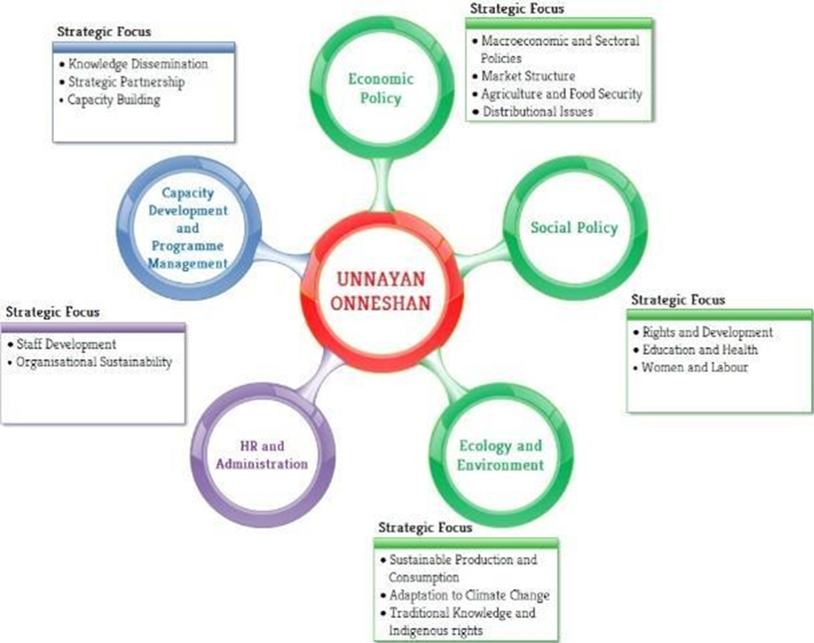
0ERATIONAL STRUCTURE
The internal professional staff and external networked fellows are grouped into three research and programme based and two function based operational units – Economic Policy, Social Policy, Climate Change, Biodiversity and DRR, and Programme and Communication, and Finance and HR. The professional staffs, with expertise in all areas of development studies, are educated and trained from top-ranking universities from both home and abroad.
Figure: Operational Units of Unnayan Onneshan

Slide 11
UO in Action
July 2020 - June 2021
Advancing Ideas and Building Constituencies for Social Transformation

Slide 12
JULY 2020

Slide 13
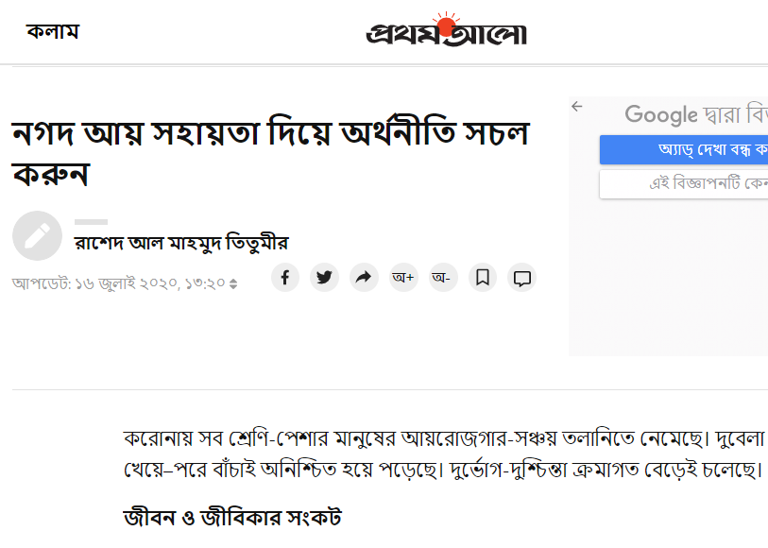
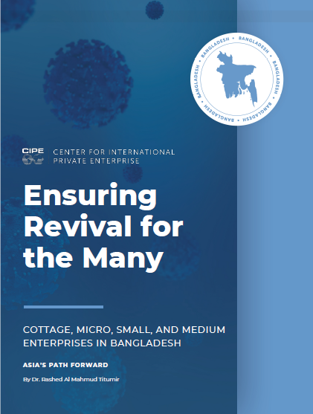
Research and Op-ed
UO has been undertaking research on the impact of COVID-19 on people’s life and
livelihood and wrote several op-ed pieces and articles in national dailies and
international platform in the month of July 2020. Accordingly, it urged the
Government to take necessary fiscal and monetary measures to recover the
economy and also attempted to identify the factors of the assumed recovery. These
are:
https://www.bd-pratidin.com/last-page/2020/07/05/545408
(Unemployment has not increased so much in 35 years)
https://www.prothomalo.com/opinion/column/%E0%A6%A8%E0%A6%97%E0%A6%A6-%E0%A6%86%E0%A7%9F-%E0%A6%B8%E0%A6%B9%E0%A6%BE%E0%A7%9F%E0%A6%A4%E0%A6%BE-%E0%A6%A6%E0%A6%BF%E0%A7%9F%E0%A7%87-%E0%A6%85%E0%A6%B0%E0%A7%8D%E0%A6%A5%E0%A6%A8%E0%A7%80%E0%A6%A4%E0%A6%BF-%E0%A6%B8%E0%A6%9A%E0%A6%B2-%E0%A6%95%E0%A6%B0%E0%A7%81%E0%A6%A8
(Recovering the economy through providing cash transfer)
An article namely— Ensuring Revival for the Many: Cottage, Micro, Small, and
Medium Enterprises in Bangladesh— has been published by Center for
International Private Enterprise (CIPE). It can be reached through:
https://www.cipe.org/resources/ensuring-revival-for-the-many-cottage-micro-small-and-medium-enterprises-in-bangladesh/?
Another article published by the Business Standard titled— Why Recovery will be Delayed— explored the reasons of delayed recovery of the econoomy from the shocks of COVID-19 pandemic.
https://tbsnews.net/thoughts/why-recovery-will-be-delayed-111496

Slide 14
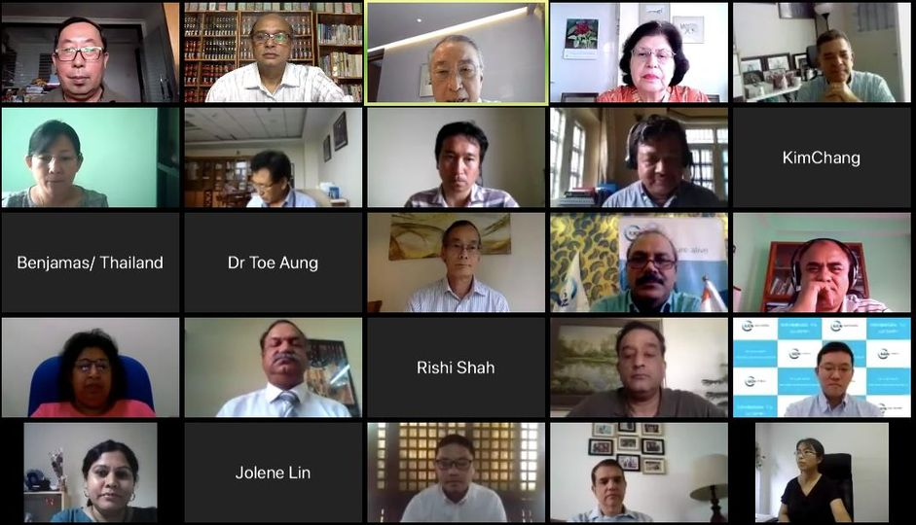
Webinar (International)
During this month, UO attended several international webinars arranged by
IUCN and Western Sydney University, Australia .
As the vice president, UO attended IUCN Asia Regional Members Committee
Meeting.
It also attended a webinar arranged by Western Sydney University, Australia on COVID-19 .

Slide 15
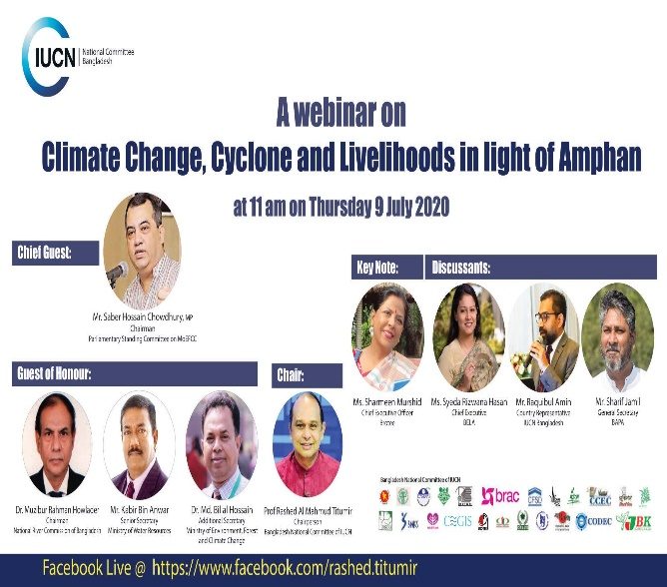
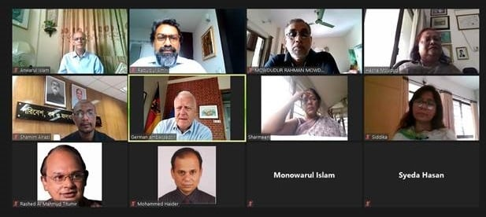
Webinar (National)
UO also made participation in many webinars hosted by IUCN national committee, CGS and other organization. These webinars were on economic, social, ecological issues. The links are:
https://www.facebook.com/TSBDNews/videos/904808816692903/
https://www.facebook.com/watch/?v=209104540471756&extid=EMIkxjgkWTqUMHMv
https://www.facebook.com/747390243/videos/10163657665315244/?extid=WELXSPLvJRPF6cq4
https://www.youtube.com/watch?v=jJKzADWq9K0&fbclid=IwAR2juEQ2aX4jCu3DugdKdjTvhXxWjPeLXC45J0ADMM03zY3FJOZQJkET6A
https://cgs-bd.com/article/753/Rebooting-the-economy-and-forthcoming-national-budget

Slide 16
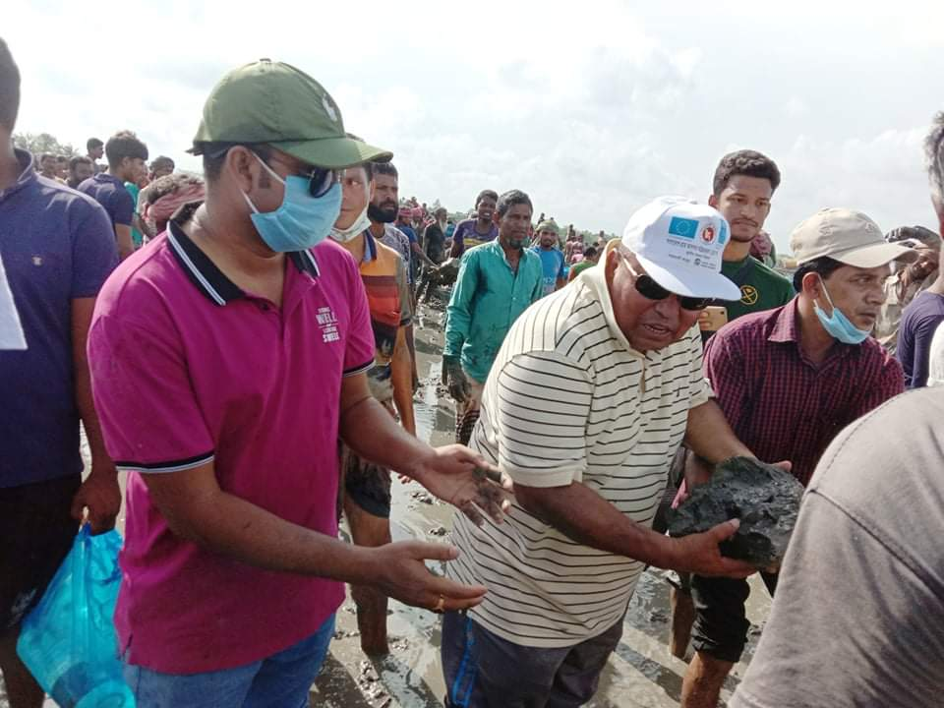
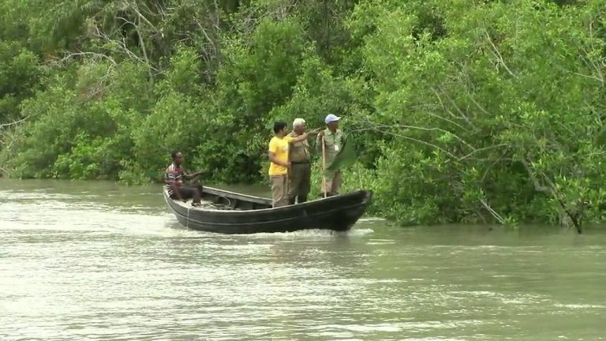
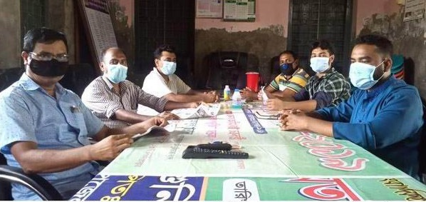
Action Research
UO kept working in the Sundarbans, facilitating forest people cooperatives, monitoring and evaluating their activities and documenting them.
In July 2020, members of the cooperatives participated with local administration to repair the embankment damaged by cyclone Amphan.
They participated with the low enforcement agency to patrol in the forest against illegal resources extraction and sat for a exchange meeting with local journalists and media representatives regarding their present socio-economic condition in the wake of COVID-19 pandemic.

Slide 17
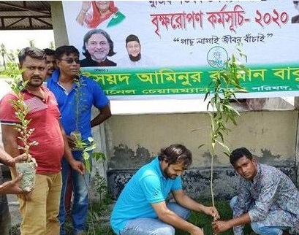
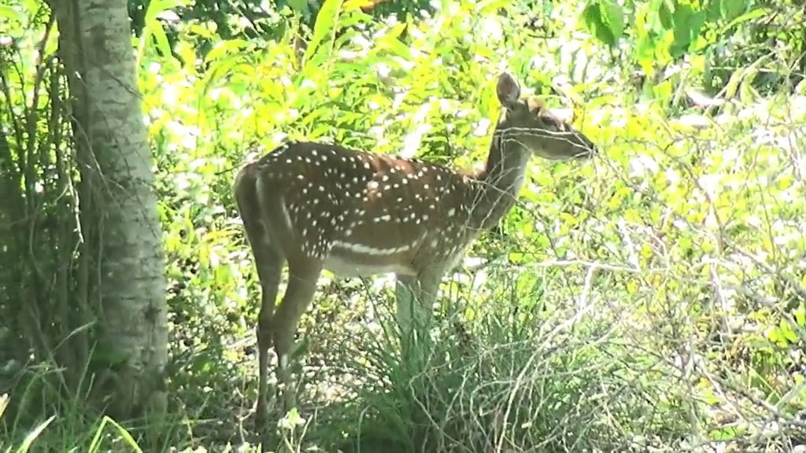
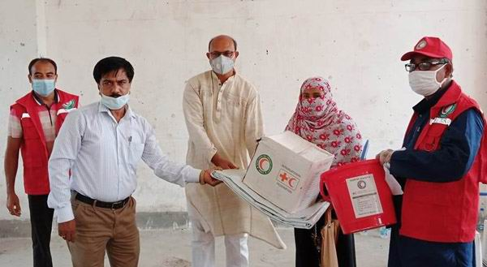
Action Research
Forest peoples’ cooperatives were also present in tree plantation program arranged by the Union Parishad.
They attended the programs for saving deer, arranged by forest department and they believe that the number of deer seems increasing since they often find deer roaming near the locality now-a-days, which was rare in recent time.
They also participated in distributing mask, sanitizer among the local people by the Red-Crescent Society to take precautionary measures against COVID-19.

Slide 18
August 2020

Slide 19
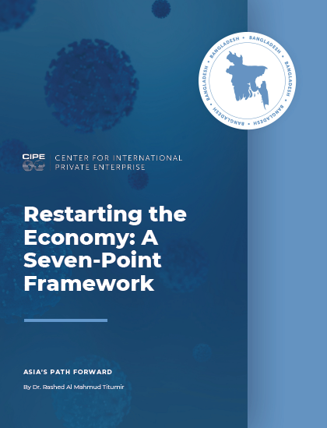
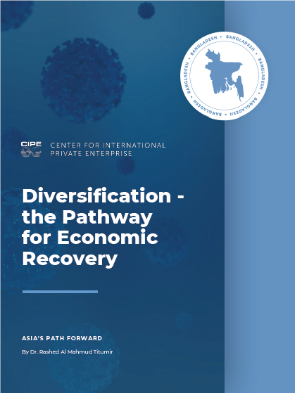
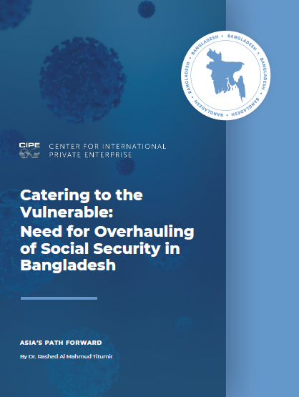
Research and Op-ed
In August 2020, three articles has been published by Center for
International Private Enterprise (CIPE). These are:
Restarting the Economy: A Seven-Point Framework
https://www.cipe.org/resources/restarting-the-economy-a-seven-point-framework/
Catering to the Vulnerable: Need for Overhauling of Social Security in
Bangladesh
https://www.cipe.org/resources/catering-to-the-vulnerable-need-for
overhauling-of-social-security-in-bangladesh/
Diversification – the Pathway for Economic Recover
https://www.cipe.org/resources/diversification-the-pathway-for-economic-recovery/
Center for Governance Studies also published an occasional paper titled— Life, Livelihood and Budget in a Pandemic Era.
https://www.cgs-bd.com/cms/media/documents/0066b70c-56e5-408b-86dd-0ed5c3c44270.pdf
The Daily Prothom Alo also published an opinion titled— Extensive reforms
needed for universal health care.

Slide 20
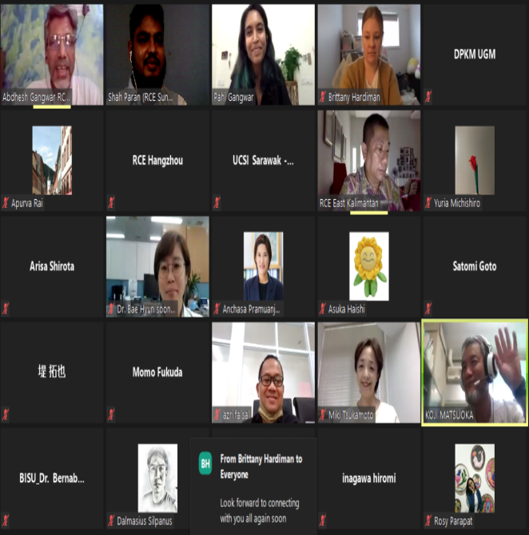
Webinar (International)
UO made an presentation in an webinar arranged by RCEs Asia-Pacific Region, on the occasion of International Day of the World's Indigenous Peoples. The presentation was on the indigenous peoples and sustainability in COVID-19 era.
It also attended a webinar arranged RCE Asia-Pacific Region— celebrating International Youth Day 2020 and made an presentation titled Youth and Sustainability.

Slide 21
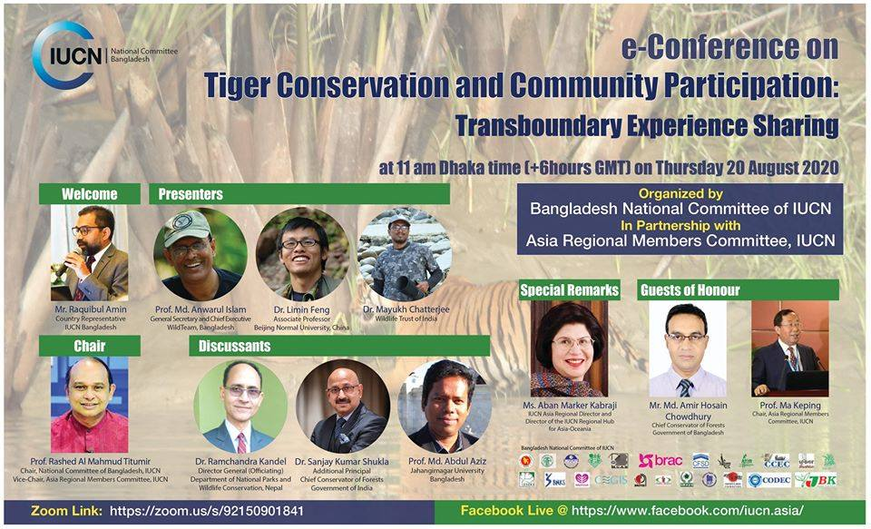
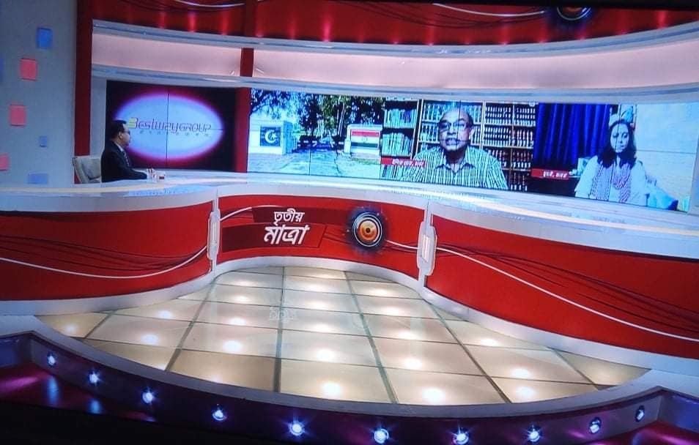
Webinar (National)
UO also participated in webinars organized in national platforms:
https://www.facebook.com/iucn.asia/videos/2020500841418149/
https://www.facebook.com/doctortv.net/videos/1256084108063480/
Electronic media participation i.e. talk show in TV channels has been continued.
https://www.youtube.com/watch?v=D4eY0xJpE70&feature=youtu.be&fbclid=IwAR3A3iBwMsV_ClEYkicjpS_dAHm62dM_U6GPa7uwY40VqF3vriRscvdwnKM
Media Engagement

Slide 22
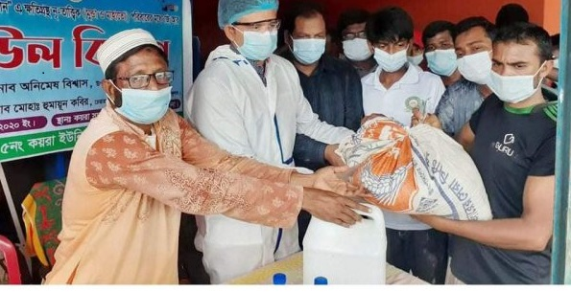
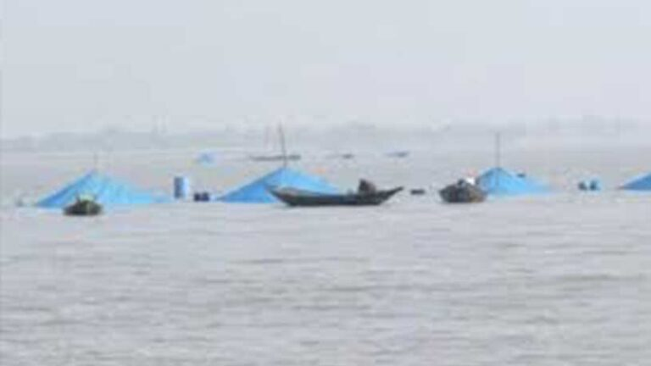
Action Research
In the Sundarbans, community members received relief from local administration and they also got engaged in distribution process.
Forest people cooperatives’ members organized awareness building program against using pernicious nets to catch fishes that kills various aquatic species. With the help of Local Agricultural Department they have planted many trees around the embankments.
They also become successful to bring their locality under electricity coverage recently through making negotiation with the local administration and political representative of that locality (MP).

Slide 23
September 2020

Slide 24
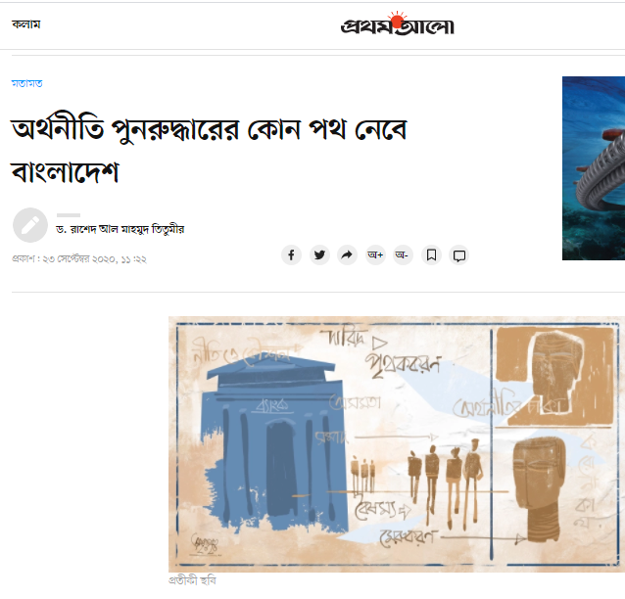
Research and Op-ed
An opinion got published in the Daily Prothom Alo in Bengali titled— “Orthoniti punoruddharer kon poth nebe Bangladesh” (Which recovery path Bangladesh may pursue?)
https://www.prothomalo.com/opinion/column/%E0%A6%85%E0%A6%B0%E0%A7%8D%E0%A6%A5%E0%A6%A8%E0%A7%80%E0%A6%A4%E0%A6%BF-%E0%A6%AA%E0%A7%81%E0%A6%A8%E0%A6%B0%E0%A7%81%E0%A6%A6%E0%A7%8D%E0%A6%A7%E0%A6%BE%E0%A6%B0%E0%A7%87%E0%A6%B0-%E0%A6%95%E0%A7%8B%E0%A6%A8-%E0%A6%AA%E0%A6%A5-%E0%A6%A8%E0%A7%87%E0%A6%AC%E0%A7%87-%E0%A6%AC%E0%A6%BE%E0%A6%82%E0%A6%B2%E0%A6%BE%E0%A6%A6%E0%A7%87%E0%A6%B6?

Slide 25
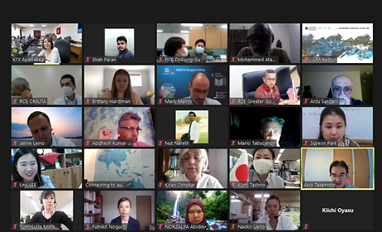
Webinar (International)
UO attended several international webinar in this month. It also made
presentation in many webinars.
https://www.youtube.com/watch?time_continue=11&v=O1UwIOIoiS4&feature=emb_logo
It attended 13th Asia Pacific RCE Regional Meeting organized by RCE Kyrgyzstan
on the Role of ESD during COVID-19 pandemic in session 1.
In session 2 in the same webinar on AP RCEs Achievements and Collaborative Initiatives in Response to COVID-19 it presented on COVID-19: Impacts, Response and Resilience in RCE Sundarbans.
It made presentation in the International Webinar on “Making Right Choices, Becoming A Responsible Consumer”: Towards Sustainable Consumption and Production (SDG 12) celebrating “Green Consumer Day” 2020, arranged by RCE East Kalimantan and RCE East Java, Indonesia. The presentation topic was- Green Consumerism in Bangladesh: Youth Perspective.
UO also attended in webinar organized by RCE Kuching on World Rivers Day 2020: Roles of Youth

Slide 26
Media Engagement
UO attended TV talk-shows to discuss socio-economic issues.
https://www.youtube.com/watch?v=gA-idu42Wro&feature=youtu.be&fbclid=IwAR2DRsUUf2GGgoVxGJxUNmuxPinPGxMUt_ds6GqaNoVviI-aqCNdskdadyQ

Slide 27
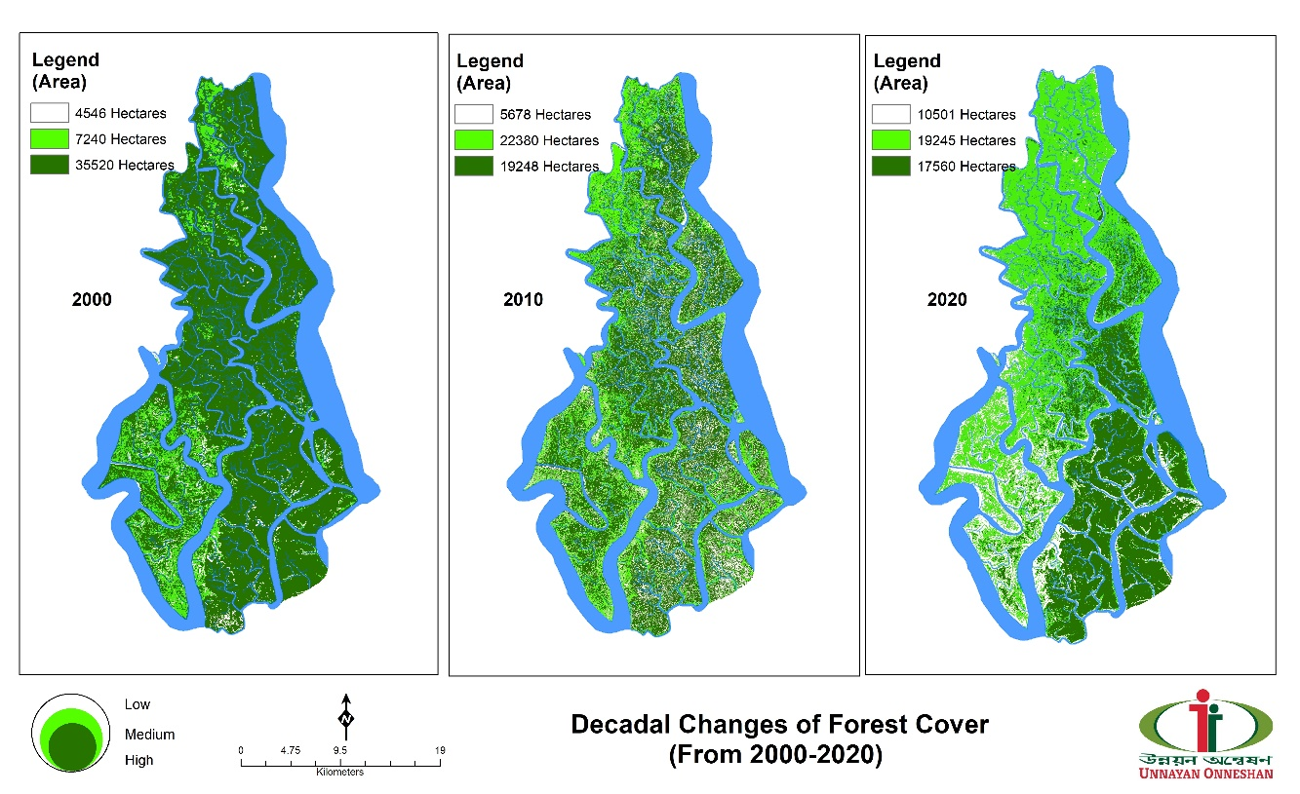
Action Research
A PPGIS study has been carried out in the Sundarbans recently by UO. The outcomes are:
1. Resource distribution map (of respective category) showing decadal changes: what resources have increased or decreased and where that changes took place in the forest
2. Landscape values map (density of the resources: showing where resource is densely distributed and where is not. And categorizing the forest areas based on the importance to the TRUs for resources collection).
3. Impact of climate change mapping (decadal variation in i.species, ii. tides, iii. temperature, iv. salinity, v. PH+ etc.) And also tagging the changes of climate change variables to the areas where resource density is low or high
4. Community plantation along the embankment of the river by the local community (total area map)
5. Land reclamation by the Munda people (total area map)
Decadal Change of Forest Coverage in the Sundarbans drawn by PPGIS

Slide 28
October 2020

Slide 29
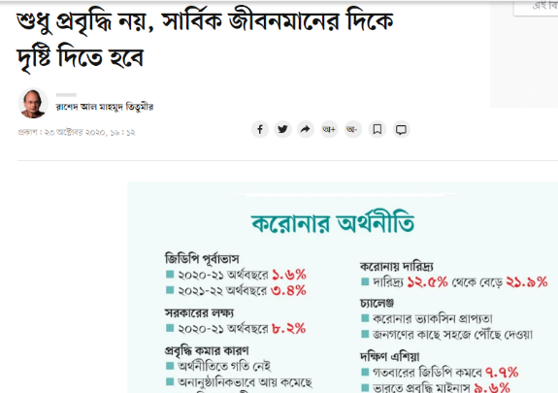
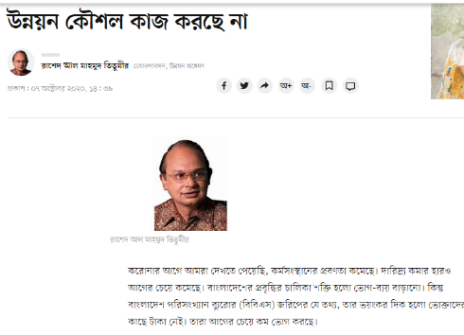
Research and Op-ed
Two opinions got published in the Daily Prothom Alo (Bengali).
করোনায় আয় কমেছে উন্নয়ন কৌশল কাজ করছে না (Income has decreased, development strategies are not working)
https://www.prothomalo.com/business/analysis/%E0%A6%89%E0%A6%A8%E0%A7%8D%E0%A6%A8%E0%A7%9F%E0%A6%A8-%E0%A6%95%E0%A7%8C%E0%A6%B6%E0%A6%B2-%E0%A6%95%E0%A6%BE%E0%A6%9C-%E0%A6%95%E0%A6%B0%E0%A6%9B%E0%A7%87-%E0%A6%A8%E0%A6%BE
শুধু প্রবৃদ্ধি নয়, সার্বিক জীবনমানের দিকে দৃষ্টি দিতে হবে (Not just growth, emphasis needed to ameliorate overall quality of life)
https://www.prothomalo.com/opinion/%E0%A6%B6%E0%A7%81%E0%A6%A7%E0%A7%81-%E0%A6%AA%E0%A7%8D%E0%A6%B0%E0%A6%AC%E0%A7%83%E0%A6%A6%E0%A7%8D%E0%A6%A7%E0%A6%BF-%E0%A6%A8%E0%A7%9F-%E0%A6%B8%E0%A6%BE%E0%A6%B0%E0%A7%8D%E0%A6%AC%E0%A6%BF%E0%A6%95-%E0%A6%9C%E0%A7%80%E0%A6%AC%E0%A6%A8%E0%A6%AE%E0%A6%BE%E0%A6%A8%E0%A7%87%E0%A6%B0-%E0%A6%A6%E0%A6%BF%E0%A6%95%E0%A7%87-%E0%A6%A6%E0%A7%83%E0%A6%B7%E0%A7%8D%E0%A6%9F%E0%A6%BF-%E0%A6%A6%E0%A6%BF%E0%A6%A4%E0%A7%87-%E0%A6%B9%E0%A6%AC%E0%A7%87?

Slide 30
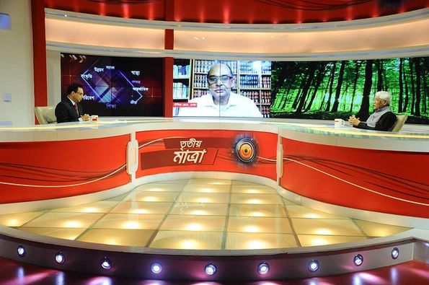
Webinar
Attended an webinar to discuss the crisis of immigrants workers in the face of COVID-19.
https://fb.watch/3GpraMB4Ls/
Media Engagement
https://www.youtube.com/watch?fbclid=IwAR1FxCFDrSXPs8T02odJstpet9qZ4sph2xooSLUK3CnKUykz2emrfKfG3VA&v=8dNi1-nPdf4&feature=youtu.be

Slide 31
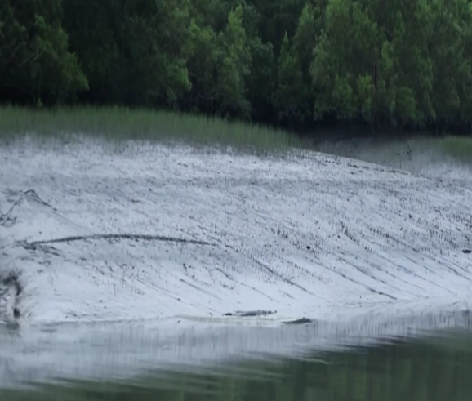
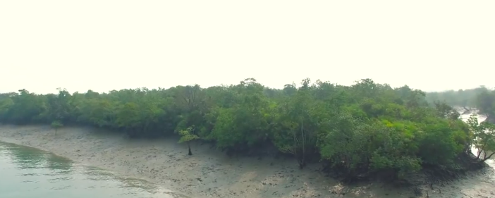
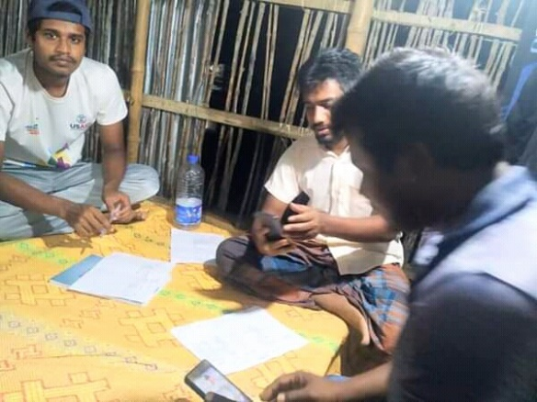
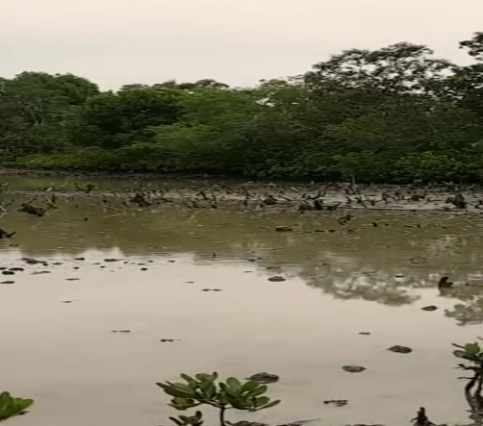
Action Research
UO documented plantation by the community members along the embankment line, which protects the locality from natural disasters such as cyclone. People also reported that the development of new char lands in many water ways in the forest is creating blocks to the flow of water, which negatively affects the life below the water in the forest.
Members of Harinagar Forest People Cooperative organized a meeting where they decided to plant Keora and golpata in fallow areas alongside the river and in char lands.

Slide 32
November 2020

Slide 33
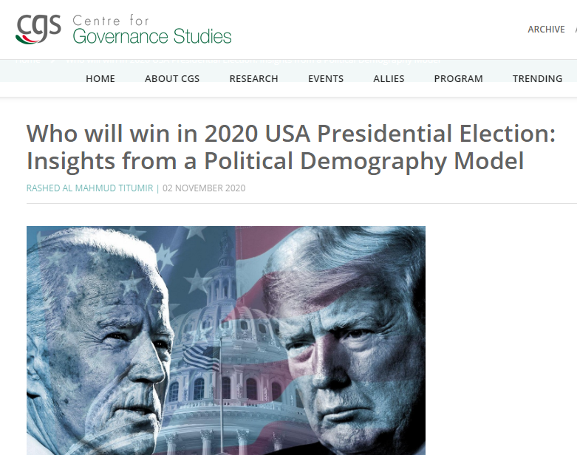
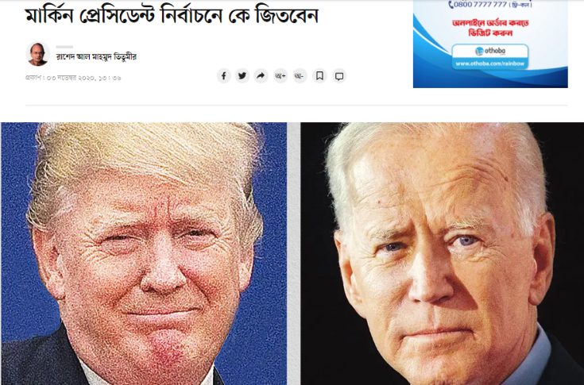
Research and Op-ed
Who will win in 2020 USA Presidential Election: Insights from a Political Demography Model
https://cgs-bd.com/article/1475/Who-will-win-in-2020-USA-Presidential-Election--Insights-from-a-Political-Demography-Model?
মার্কিন প্রেসিডেন্ট নির্বাচনে কে জিতবেন (Who will win in 2020 USA Presidential Election in Daily Prothom Alo)
https://www.prothomalo.com/opinion/%E0%A6%AE%E0%A6%BE%E0%A6%B0%E0%A7%8D%E0%A6%95%E0%A6%BF%E0%A6%A8-%E0%A6%AA%E0%A7%8D%E0%A6%B0%E0%A7%87%E0%A6%B8%E0%A6%BF%E0%A6%A1%E0%A7%87%E0%A6%A8%E0%A7%8D%E0%A6%9F-%E0%A6%A8%E0%A6%BF%E0%A6%B0%E0%A7%8D%E0%A6%AC%E0%A6%BE%E0%A6%9A%E0%A6%A8%E0%A7%87-%E0%A6%95%E0%A7%87-%E0%A6%9C%E0%A6%BF%E0%A6%A4%E0%A6%AC%E0%A7%87%E0%A6%A8?
সহায়তা কেন সবার কাছে পৌঁছাতে পারছে না ( Why fiscal assistance is not reaching to all)
https://www.prothomalo.com/opinion/column/%E0%A6%B8%E0%A6%B9%E0%A6%BE%E0%A7%9F%E0%A6%A4%E0%A6%BE-%E0%A6%95%E0%A7%87%E0%A6%A8-%E0%A6%B8%E0%A6%AC%E0%A6%BE%E0%A6%B0-%E0%A6%95%E0%A6%BE%E0%A6%9B%E0%A7%87-%E0%A6%AA%E0%A7%8C%E0%A6%81%E0%A6%9B%E0%A6%BE%E0%A6%A4%E0%A7%87-%E0%A6%AA%E0%A6%BE%E0%A6%B0%E0%A6%9B%E0%A7%87-%E0%A6%A8%E0%A6%BE?

Slide 34
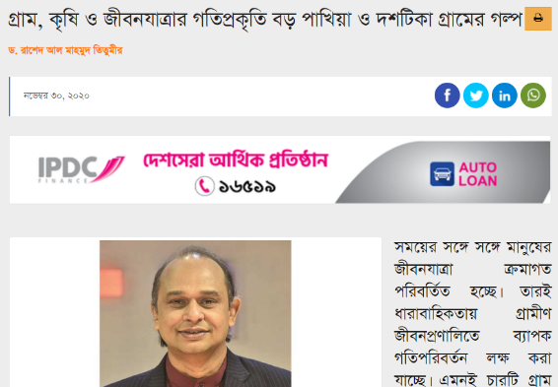
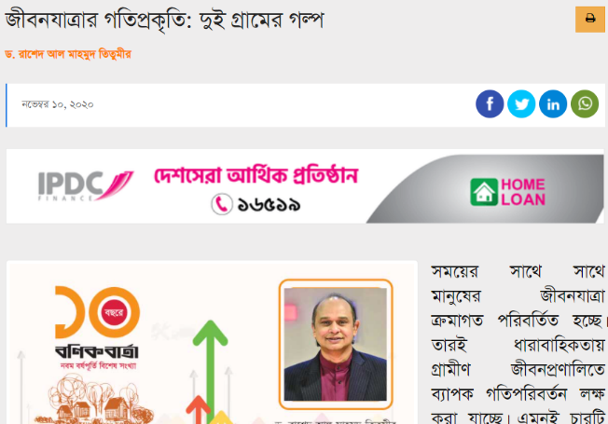
Research and Op-ed
A series of articles (three parts) got published in Daily Banik Barta in Bengali. These are about the life and livelihood of peasants in different villages of different district and on agricultural development. In November, two article of the series got published.
জীবনযাত্রার গতিপ্রকৃতি: দুই গ্রামের গল্প ( Story of life in two villages in Cumilla)
https://bonikbarta.net/home/news_description/246974
গ্রাম, কৃষি ও জীবনযাত্রার গতিপ্রকৃতি বড় পাখিয়া ও দশটিকা গ্রামের গল্প (The story of life, village and agriculture in Boropakhia and Doshtika gram).
https://bonikbarta.net/home/news_description/248729

Slide 35
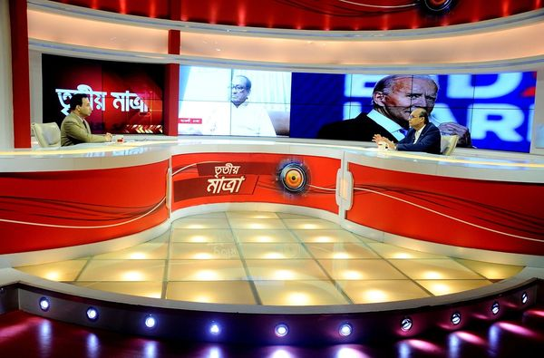
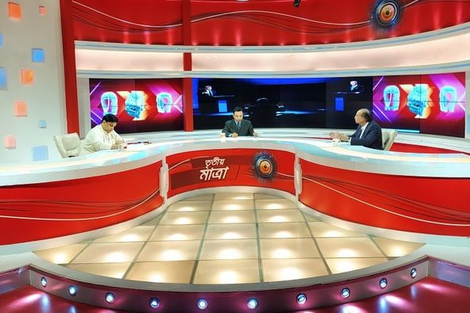
Media Engagement
UO participated on Talk-shows on contemporary issues.
https://www.youtube.com/watch?fbclid=IwAR1Hv_msV6gTtdRna7b01DyUXTV7GsUp4uQPeebpmv5U7zlMxwnmxwrljWk&v=bBTF86WsuM0&feature=youtu.be
https://www.youtube.com/watch?v=Gc7DH1ElssI&fbclid=IwAR135TUUr5xWDgJtXh7LgM6MGgV0tTbeG_ah_K9lOdEIhn73Fvz_8dLiOAo

Slide 36
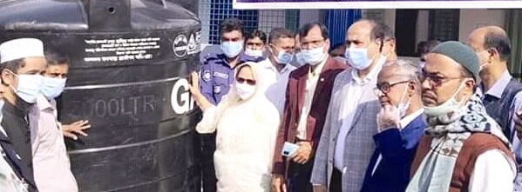
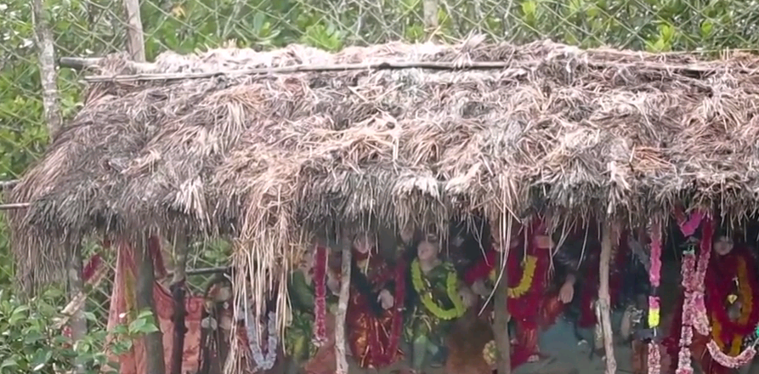
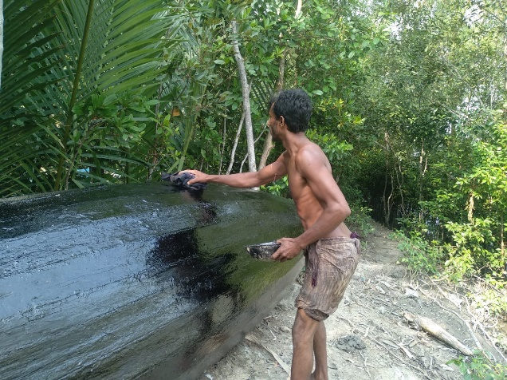
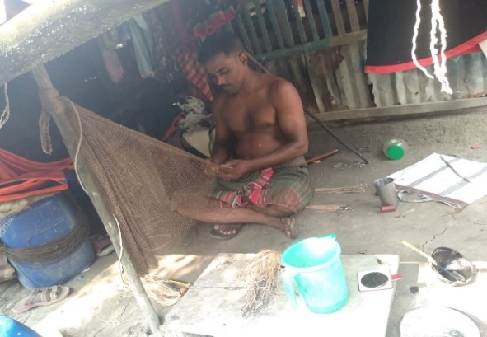
Action Research
UO reported participation of forest people in the inauguration ceremony of free blood donation campaign by the local government in Koyra. Forest people received a water tank provided by a NGO for clean water in the Union Parishad. They said Hindu community among the Forest people perform certain religious ritual such as worshiping idol and bonobibi as their belief system before going to forest..
The Harinagar Forest people cooperative arranged an exchange meeting with the chairman of union parishad.
A TRU preparing his boat (left) and another TRU repair his fishing nets as they have been planning to go to the forest for fishing soon.

Slide 37
December 2020

Slide 38
Research and Op-ed
Several article published in Bengali and English dailies.
Averting K-shaped recovery
https://www.newagebd.net/article/124458/averting-k-shaped-recovery
অনিশ্চয়তা ও বৈষম্য দূর করার পথ কী (What is the way to overcome uncertainty and inequality)
https://www.prothomalo.com/opinion/column/%E0%A6%85%E0%A6%A8%E0%A6%BF%E0%A6%B6%E0%A7%8D%E0%A6%9A%E0%A7%9F%E0%A6%A4%E0%A6%BE-%E0%A6%93-%E0%A6%AC%E0%A7%88%E0%A6%B7%E0%A6%AE%E0%A7%8D%E0%A6%AF-%E0%A6%A6%E0%A7%82%E0%A6%B0-%E0%A6%95%E0%A6%B0%E0%A6%BE%E0%A6%B0-%E0%A6%AA%E0%A6%A5-%E0%A6%95%E0%A7%80?
গ্রাম, কৃষি ও জীবনযাত্রার গতিপ্রকৃতি বড় পাখিয়া ও দশটিকা গ্রামের গল্প (The story of life, village and agriculture in Boropakhia and Doshtika gram).
https://bonikbarta.net/home/news_description/248825
সমাজে ভাঙন, যুবকদের অনিশ্চয়তা ও রাষ্ট্রের দায় (The breakdown in society, the precarity of the youth and the responsibility of the state)
https://www.prothomalo.com/opinion/column/%E0%A6%B8%E0%A6%AE%E0%A6%BE%E0%A6%9C%E0%A7%87-%E0%A6%AD%E0%A6%BE%E0%A6%99%E0%A6%A8-%E0%A6%AF%E0%A7%81%E0%A6%AC%E0%A6%95%E0%A6%A6%E0%A7%87%E0%A6%B0-%E0%A6%85%E0%A6%A8%E0%A6%BF%E0%A6%B6%E0%A7%8D%E0%A6%9A%E0%A7%9F%E0%A6%A4%E0%A6%BE-%E0%A6%93-%E0%A6%B0%E0%A6%BE%E0%A6%B7%E0%A7%8D%E0%A6%9F%E0%A7%8D%E0%A6%B0%E0%A7%87%E0%A6%B0-%E0%A6%A6%E0%A6%BE%E0%A7%9F?
করোনাক্রান্তিতে যাপিত জীবন (Life in the days of COVID)
https://bonikbarta.net/home/news_description/251803/%E0%A6%95%E0%A6%B0%E0%A7%8B%E0%A6%A8%E0%A6%BE%E0%A6%95%E0%A7%8D%E0%A6%B0%E0%A6%BE%E0%A6%A8%E0%A7%8D%E0%A6%A4%E0%A6%BF%E0%A6%A4%E0%A7%87-%E0%A6%AF%E0%A6%BE%E0%A6%AA%E0%A6%BF%E0%A6%A4-%E0%A6%9C%E0%A7%80%E0%A6%AC%E0%A6%A8?

Slide 39
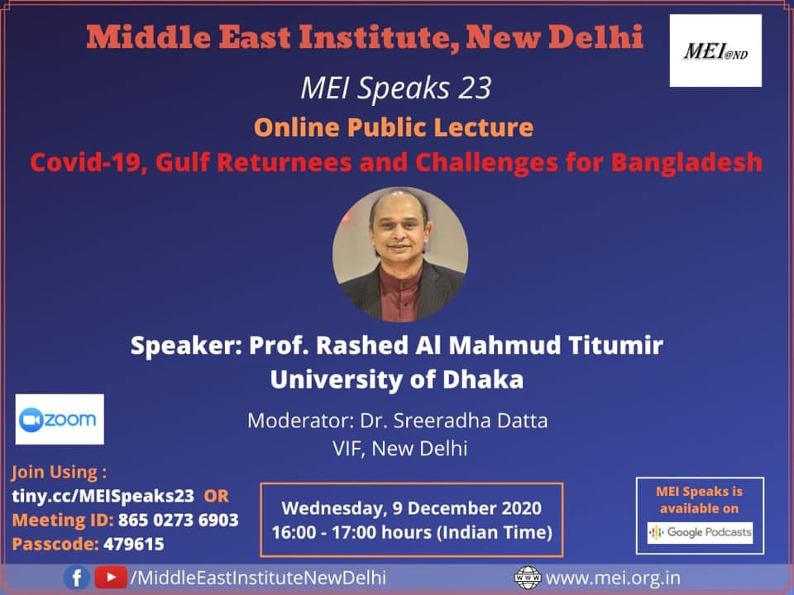
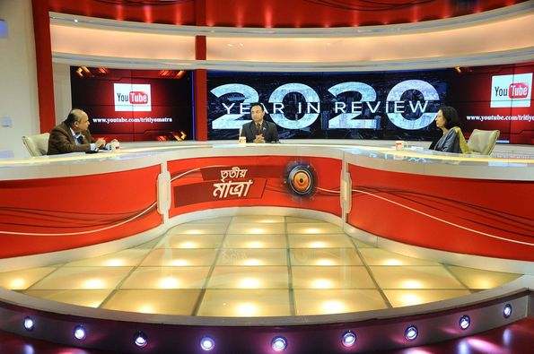
Webinar (International)
UO attended in webinar organized by Middle East Institute, New Delhi and delivered speech on COVID-19, Gulf Returnees and Challenges for Bangladesh.
https://www.youtube.com/watch?v=6W4C0Qd2-rc&feature=share&fbclid=IwAR2bG9qJZBGY50_W8phPkUVuodw9wzDWRafiJ-spdkKpUXdTqF8bIx4vGlc
Media Engagement
https://www.youtube.com/watch?v=AYYw-rQbZ4U

Slide 40
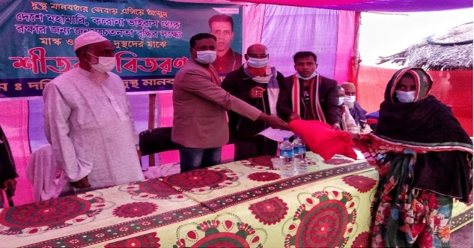
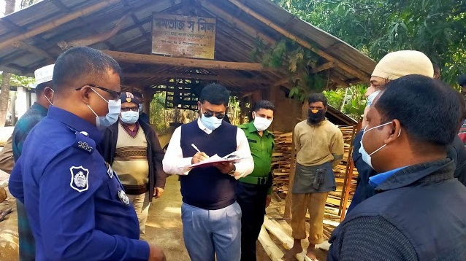
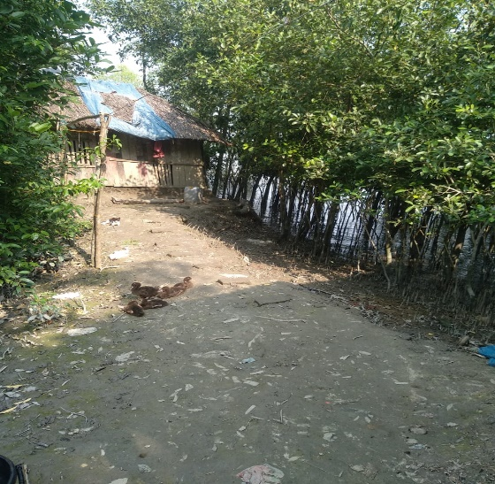
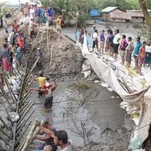
Action Research
Traditional resource users (TRUs) received face mask amidst COVID-19 and blanket amidst winter season from local government in Amadi union. The Local govenment representative punished people and imposed fine for cutting tress illegally from the forest.
There has been plantation programme by community members alongside the embankment of rivers (WAPDA) which protects houses. Besides, community members repaired the embankment of the rivers voluntarily that became damaged due to flood and cyclone Amphan .

Slide 41
January 2021

Slide 42
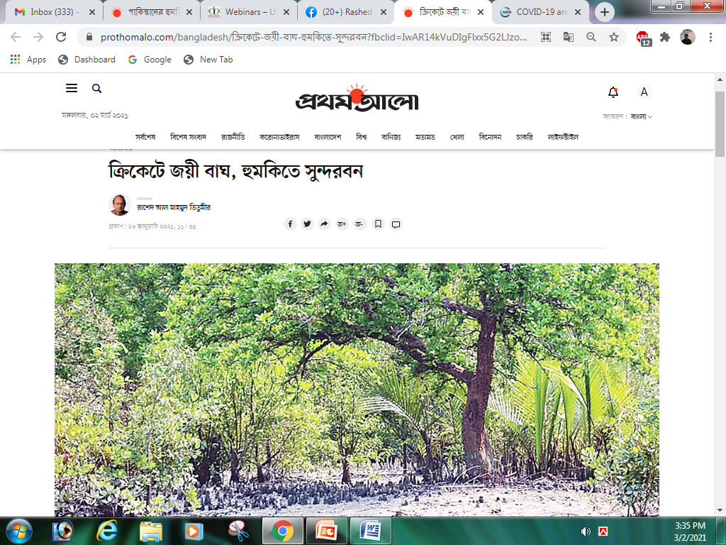
Research and Op-ed
COVID-19 and Climate Change: Double Jeopardy for Traditional Resource Users in the Sundarbans.
https://www.iucn.org/news/commission-environmental-economic-and-social-policy/202101/covid-19-and-climate-change-double-jeopardy-traditional-resource-users-sundarbans?
ক্রিকেটে জয়ী বাঘ, হুমকিতে সুন্দরবন (The Sundarbans is at stake)
https://www.prothomalo.com/bangladesh/%E0%A6%95%E0%A7%8D%E0%A6%B0%E0%A6%BF%E0%A6%95%E0%A7%87%E0%A6%9F%E0%A7%87-%E0%A6%9C%E0%A7%9F%E0%A7%80-%E0%A6%AC%E0%A6%BE%E0%A6%98-%E0%A6%B9%E0%A7%81%E0%A6%AE%E0%A6%95%E0%A6%BF%E0%A6%A4%E0%A7%87-%E0%A6%B8%E0%A7%81%E0%A6%A8%E0%A7%8D%E0%A6%A6%E0%A6%B0%E0%A6%AC%E0%A6%A8?

Slide 43
Webinar (National)
UO attended in webinar organized by Universal Research Care
https://www.facebook.com/doctortv.net/videos/3596132623834199/
https://www.youtube.com/watch?v=-cHB5S1rbRo&feature=share&fbclid=IwAR2oPPt5BDmdnL8R35qFz13fCotvk3lEJmUSeh600-IqwD3aIFRcv5vzHZQ
Media Engagement

Slide 44
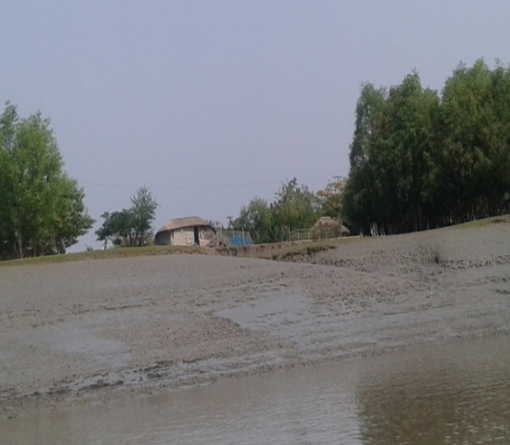
Action Research
Erosion in WAPDA embankment road has decreased and tree planting has continued. Forest people from Koyra, Harinagar cooperative have started planting trees.
Forest people from Koyra Sadar upazilla have attended in awareness meetings organized by local government . The programme has been organized to make people aware of staying safe from the corona virus. Local government also provided allowances to the elderly people of Koyra Bonojibi Samiti, Adivasi Munda Bonojbi Samiti and Harinagar Bonojibi Samiti.

Slide 45
February 2021

Slide 46
Research and Op-ed
SDGs: Where are we in achieving them?
https://www.thedailystar.net/supplements/30th-anniversary-supplements/news/sdgs-where-are-we-achieving-them-2042609
অর্থনীতি পুনরুদ্ধারে সরকারি অর্থের সদ্ব্যবহারই পথ (Utilizing government funds is the way to revive the economy)
https://www.prothomalo.com/opinion/%E0%A6%85%E0%A6%B0%E0%A7%8D%E0%A6%A5%E0%A6%A8%E0%A7%80%E0%A6%A4%E0%A6%BF-%E0%A6%AA%E0%A7%81%E0%A6%A8%E0%A6%B0%E0%A7%81%E0%A6%A6%E0%A7%8D%E0%A6%A7%E0%A6%BE%E0%A6%B0%E0%A7%87-%E0%A6%B8%E0%A6%B0%E0%A6%B0%E0%A6%95%E0%A6%BE%E0%A6%B0%E0%A6%BF-%E0%A6%85%E0%A6%B0%E0%A7%8D%E0%A6%A5%E0%A7%87%E0%A6%B0-%E0%A6%B8%E0%A6%A6%E0%A7%8D%E0%A6%AC%E0%A7%8D%E0%A6%AF%E0%A6%AC%E0%A6%B9%E0%A6%BE%E0%A6%B0%E0%A6%87-%E0%A6%AA%E0%A6%A5?

Slide 47
Media Engagement
https://www.facebook.com/photo?fbid=10157712103682410&set=ms.c.eJwFwQcRADAMAzFGvbzjLP7EKqWlPrMutNWPoGYQkb0y8QF4WwbW.bps.
https://www.facebook.com/photo?fbid=10158940199427410&set=pcb.10158940200677410

Slide 48
Action Research
The trees next to the WAPDA embankment are growing and river erosion is being prevented. At present, due to the planting of trees near WAPDA, more fish are being found in the shades of the trees.
In Koyra Upazila, 50 families including homeless and widows were provided with pucca houses in a 200 plots of land. Upazila Social Service Officer Upazila Chairman, Upazila Project Implementation Officer and Union Parishad Chairman were present on the occasion.

Slide 49
March 2021

Slide 50
Research and Op-ed
বন্যেরা বনে সুন্দর নেই ( Wild are not well in the woods)
https://www.prothomalo.com/bangladesh/environment/%E0%A6%AC%E0%A6%A8%E0%A7%8D%E0%A6%AF%E0%A7%87%E0%A6%B0%E0%A6%BE-%E0%A6%AC%E0%A6%A8%E0%A7%87-%E0%A6%B8%E0%A7%81%E0%A6%A8%E0%A7%8D%E0%A6%A6%E0%A6%B0-%E0%A6%A8%E0%A7%87%E0%A6%87?
অর্থনীতি পুনরুদ্ধারে দরকার নদীর মতো নেটওয়ার্ক (A river-like investment network is needed for economic recovery)
https://www.prothomalo.com/opinion/column/%E0%A6%85%E0%A6%B0%E0%A7%8D%E0%A6%A5%E0%A6%A8%E0%A7%80%E0%A6%A4%E0%A6%BF-%E0%A6%AA%E0%A7%81%E0%A6%A8%E0%A6%B0%E0%A7%81%E0%A6%A6%E0%A7%8D%E0%A6%A7%E0%A6%BE%E0%A6%B0%E0%A7%87-%E0%A6%A6%E0%A6%B0%E0%A6%95%E0%A6%BE%E0%A6%B0-%E0%A6%A8%E0%A6%A6%E0%A7%80%E0%A6%B0-%E0%A6%AE%E0%A6%A4%E0%A7%8B-%E0%A6%A8%E0%A7%87%E0%A6%9F%E0%A6%93%E0%A7%9F%E0%A6%BE%E0%A6%B0%E0%A7%8D%E0%A6%95?
জীবন বাঁচাতে বন সংরক্ষণ ও পুনরুদ্ধার (Forest conservation and restoration to save lives)
https://www.prothomalo.com/bangladesh/%E0%A6%9C%E0%A7%80%E0%A6%AC%E0%A6%A8-%E0%A6%AC%E0%A6%BE%E0%A6%81%E0%A6%9A%E0%A6%BE%E0%A6%A4%E0%A7%87-%E0%A6%AC%E0%A6%A8-%E0%A6%B8%E0%A6%82%E0%A6%B0%E0%A6%95%E0%A7%8D%E0%A6%B7%E0%A6%A3-%E0%A6%93-%E0%A6%AA%E0%A7%81%E0%A6%A8%E0%A6%B0%E0%A7%81%E0%A6%A6%E0%A7%8D%E0%A6%A7%E0%A6%BE%E0%A6%B0?
জলের জীবন ফুরালে মানুষের জীবন বাঁচে কি (Can human beings survive when the life of water is over)
https://www.prothomalo.com/bangladesh/%E0%A6%9C%E0%A6%B2%E0%A7%87%E0%A6%B0-%E0%A6%9C%E0%A7%80%E0%A6%AC%E0%A6%A8-%E0%A6%AB%E0%A7%81%E0%A6%B0%E0%A6%BE%E0%A6%B2%E0%A7%87-%E0%A6%AE%E0%A6%BE%E0%A6%A8%E0%A7%81%E0%A6%B7%E0%A7%87%E0%A6%B0-%E0%A6%9C%E0%A7%80%E0%A6%AC%E0%A6%A8-%E0%A6%AC%E0%A6%BE%E0%A6%81%E0%A6%9A%E0%A7%87-%E0%A6%95%E0%A6%BF?
নব্বইয়ের দশকে ব্যক্তি খাতের বিকাশ ও রাষ্ট্রের সক্রিয়তা (The development of the private sector and the active state in the nineties)
https://bonikbarta.net/home/news_description/259415/%E0%A6%A8%E0%A6%AC%E0%A7%8D%E0%A6%AC%E0%A6%87%E0%A7%9F%E0%A7%87%E0%A6%B0-%E0%A6%A6%E0%A6%B6%E0%A6%95%E0%A7%87-%E0%A6%AC%E0%A7%8D%E0%A6%AF%E0%A6%95%E0%A7%8D%E0%A6%A4%E0%A6%BF-%E0%A6%96%E0%A6%BE%E0%A6%A4%E0%A7%87%E0%A6%B0-%E0%A6%AC%E0%A6%BF%E0%A6%95%E0%A6%BE%E0%A6%B6-%E0%A6%93-%E0%A6%B0%E0%A6%BE%E0%A6%B7%E0%A7%8D%E0%A6%9F%E0%A7%8D%E0%A6%B0%E0%A7%87%E0%A6%B0-%E0%A6%B8%E0%A6%95%E0%A7%8D%E0%A6%B0%E0%A6%BF%E0%A7%9F%E0%A6%A4%E0%A6%BE?

Slide 51
Media Engagement
Interview by Xinhua: China shows employment vital to economic recovery
https://www.thestar.com.my/aseanplus/aseanplus-news/2021/03/15/china-shows-employment-vital-to-economic-recovery-expert-says?
https://www.youtube.com/watch?v=XWQgGlXeBpA
https://www.youtube.com/watch?v=7YzdLNuZ67M

Slide 52
Action Research
Traditional resource users (TRUs) are catching fish using traditional net that does not kill small fish and larvae. Forest people are becoming more aware of the negative impact of using “current jal” that kills small fish. Recently the amount of shrimp harvesting from the Sundarbans has increased. The conservation initiative taken by the cooperative members is yielding positive outcome in the area.
A TRU women is receiving weaving machine from the local government officials, which is a outcome of TRUs’ increased ability to claim social entitlements and negotiate with different stakeholders (Photo-left).
The members of Harinagar Forest People Cooperative are discussing various issues such as golpata culture, honey and wax culture, fishing and socio-economic issues during the pandemic. This is a monthly gathering to exchange challenges, priorities, success and other relevant issues among the cooperative members (Photo-right).

Slide 53
April 2021

Slide 54
Research and Op-ed
নগদ সহায়তাই কোভিডের অভিঘাত মোকাবিলার পথ (Cash assistance is the way to deal with COVID-19 shock)
https://www.prothomalo.com/opinion/column/%E0%A6%A8%E0%A6%97%E0%A6%A6-%E0%A6%B8%E0%A6%B9%E0%A6%BE%E0%A7%9F%E0%A6%A4%E0%A6%BE%E0%A6%87-%E0%A6%95%E0%A7%8B%E0%A6%AD%E0%A6%BF%E0%A6%A1%E0%A7%87%E0%A6%B0-%E0%A6%85%E0%A6%AD%E0%A6%BF%E0%A6%98%E0%A6%BE%E0%A6%A4-%E0%A6%AE%E0%A7%8B%E0%A6%95%E0%A6%BE%E0%A6%AC%E0%A6%BF%E0%A6%B2%E0%A6%BE%E0%A6%B0-%E0%A6%AA%E0%A6%A5-2?
টিকা পাওয়ার সব পথই খোলা রাখতে হবে (All avenues for vaccination must be kept open)
https://www.prothomalo.com/opinion/column/%E0%A6%9F%E0%A6%BF%E0%A6%95%E0%A6%BE-%E0%A6%AA%E0%A6%BE%E0%A6%93%E0%A7%9F%E0%A6%BE%E0%A6%B0-%E0%A6%B8%E0%A6%AC-%E0%A6%AA%E0%A6%A5%E0%A6%87-%E0%A6%96%E0%A7%87%E0%A6%BE%E0%A6%B2%E0%A6%BE-%E0%A6%B0%E0%A6%BE%E0%A6%96%E0%A6%A4%E0%A7%87-%E0%A6%B9%E0%A6%AC%E0%A7%87?
জীবাশ্ম জ্বালানির ফাঁদ থেকে বেরোতে হবে (Need to get out of fossil fuels)
https://www.prothomalo.com/bangladesh/%E0%A6%9C%E0%A7%80%E0%A6%AC%E0%A6%BE%E0%A6%B6%E0%A7%8D%E0%A6%AE-%E0%A6%9C%E0%A7%8D%E0%A6%AC%E0%A6%BE%E0%A6%B2%E0%A6%BE%E0%A6%A8%E0%A6%BF%E0%A6%B0-%E0%A6%AB%E0%A6%BE%E0%A6%81%E0%A6%A6-%E0%A6%A5%E0%A7%87%E0%A6%95%E0%A7%87-%E0%A6%AC%E0%A7%87%E0%A6%B0%E0%A7%8B%E0%A6%A4%E0%A7%87-%E0%A6%B9%E0%A6%AC%E0%A7%87?

Slide 55
Media Engagement
Interview by Prothom alo: Although the poor have increased, the cash assistance is 35 lakh
https://www.prothomalo.com/business/economics/%E0%A6%97%E0%A6%B0%E0%A6%BF%E0%A6%AC-%E0%A6%AC%E0%A6%BE%E0%A7%9C%E0%A6%B2%E0%A7%87%E0%A6%93-%E0%A6%A8%E0%A6%97%E0%A6%A6-%E0%A6%B8%E0%A6%B9%E0%A6%BE%E0%A7%9F%E0%A6%A4%E0%A6%BE-%E0%A7%A9%E0%A7%AB-%E0%A6%B2%E0%A6%BE%E0%A6%96%E0%A6%95%E0%A7%87%E0%A6%87?
Interview by Bangladesh Protidin: The wheel of the economy will turn when money reaches the hands of the people
https://www.bd-pratidin.com/first-page/2021/04/17/639824?
Interview by Bangladesh Protidin: Alternative measures must be used to resolve disputes
https://www.bd-pratidin.com/first-page/2021/05/19/650452?

Slide 56
Action Research
For collecting honey and wax, mowals of the Sundarbans are going into the
forest through boat (Photo-left). They collect honey and wax from April to
June. They are making smoke on leaves of the forest trees using fire for collecting honey. They follow certain traditional rule and practices that are sustainable ways of resource collection.
While collecting honey the Mouals ensure that only a certain portion which is about two-thirds of the beehive is cut for honey collection. Rest of the beehive is left behind on the branches for the bees to return and resume their work. To ensure that young bees are not killed during the collecting process, the collectors squeeze the hive with their hand and refrain from using metal tools and to chase of the bees, smoke is produced using dry leaves and it is ensured carefully that beehive is not put on fire. After one round of collection, the Mouals revisit the same colony only after a month depending on the size of the colony and the flowering condition of nearby vegetation to stall overexploitation.

Slide 57
May 2021

Slide 58
Research and Op-ed
ধনধান্য পুষ্পজলে ভরা বাংলাদেশ (Bangladesh with full of flowers, water and plants)
https://www.prothomalo.com/opinion/%E0%A6%A7%E0%A6%A8%E0%A6%A7%E0%A6%BE%E0%A6%A8%E0%A7%8D%E0%A6%AF-%E0%A6%AA%E0%A7%81%E0%A6%B7%E0%A7%8D%E0%A6%AA%E0%A6%9C%E0%A6%B2%E0%A7%87-%E0%A6%AD%E0%A6%B0%E0%A6%BE-%E0%A6%AC%E0%A6%BE%E0%A6%82%E0%A6%B2%E0%A6%BE%E0%A6%A6%E0%A7%87%E0%A6%B6?
Averting K-shaped recovery
http://www.newagebd.net/article/138960/averting-k-shaped-recovery?
বৈষম্যমূলক পুনরুদ্ধার এড়াতে প্রয়োজন নীতিগত ও প্রাতিষ্ঠানিক সংস্কার (Policy and institutional reforms are needed to avoid discriminatory recovery)
https://bonikbarta.net/home/news_description/264821

Slide 59
Research and Op-ed
PRE-BUDGET POLICY PAPER | VOLUME 01 NO. 01. MAY 2021
From Squeeze to Expansion: Policy and Institutional Reforms for Averting K-shaped Recovery

Slide 60
Media Engagement
https://www.youtube.com/watch?v=-PSlOjBQy2I
https://www.youtube.com/watch?v=gw3XroD7lyY

Slide 61
Action Research
There has been floods due to tidal upsurge. The rainy season has also started. The increasing flood water in the Sundarbans has caused a deer coming into the locality. However, forest people are always aware of taking care of any species that are facing devastating impacts of any natural disasters. Hence, they handed over the deer to the local authority. These community based initiative to monitor and protect the wildlife and biodiversity in the Sundarbans.
The members of Harinagar forest people cooperative (photo- upper right) and Koyra forest people cooperative (Photo- lower left) in respective monthly meeting are discussing on rising issues such as floods, COVID-19 pandemic etc.
Cooperative members also attended voluntarily to repair the embankments that have been washed away by fresh flood caused by tidal upsurge. Every year these embankments get broken. However, government’s initiative is not enough and effective to overcome this crisis. Hence, TRUs also arranged Human-Chain demanding sustainable and strong embankment in the locality.

Slide 62
June 2021

Slide 63
Research and Op-ed
অর্থনীতি কেন সংকুচিত হলো (Why the economy has shrunk)
https://www.prothomalo.com/opinion/%E0%A6%85%E0%A6%B0%E0%A7%8D%E0%A6%A5%E0%A6%A8%E0%A7%80%E0%A6%A4%E0%A6%BF-%E0%A6%95%E0%A7%87%E0%A6%A8-%E0%A6%B8%E0%A6%82%E0%A6%95%E0%A7%81%E0%A6%9A%E0%A6%BF%E0%A6%A4-%E0%A6%B9%E0%A6%B2%E0%A7%8B?
Have the instruments been used effectively for recovery?
https://www.tbsnews.net/economy/budget/have-instruments-been-used-effectively-recovery-254578?
বাজেটে সর্বজনীন খাতে বরাদ্দ সংকোচন (Budget allocation to the public sector decreased)
https://www.bhorerkagoj.com/2021/06/05/%e0%a6%ac%e0%a6%be%e0%a6%9c%e0%a7%87%e0%a6%9f%e0%a7%87-%e0%a6%b8%e0%a6%b0%e0%a7%8d%e0%a6%ac%e0%a6%9c%e0%a6%a8%e0%a7%80%e0%a6%a8-%e0%a6%96%e0%a6%be%e0%a6%a4%e0%a7%87-%e0%a6%ac%e0%a6%b0%e0%a6%be/?
বাজেট অর্থনীতির অধোগতি থামাতে পারবে কি (Can the budget stop the downturn of the economy?
https://www.prothomalo.com/opinion/reaction/%E0%A6%AC%E0%A6%BE%E0%A6%9C%E0%A7%87%E0%A6%9F-%E0%A6%85%E0%A6%B0%E0%A7%8D%E0%A6%A5%E0%A6%A8%E0%A7%80%E0%A6%A4%E0%A6%BF%E0%A6%B0-%E0%A6%85%E0%A6%A7%E0%A7%8B%E0%A6%97%E0%A6%A4%E0%A6%BF-%E0%A6%A5%E0%A6%BE%E0%A6%AE%E0%A6%BE%E0%A6%A4%E0%A7%87-%E0%A6%AA%E0%A6%BE%E0%A6%B0%E0%A6%AC%E0%A7%87-%E0%A6%95%E0%A6%BF?
Will allocations help recover lives and livelihoods?
http://www.newagebd.net/article/139762/will-allocations-help-recover-lives-and-livelihoods?
প্রস্তাবিত বাজেট: জীবন-জীবিকা কি পুনরুদ্ধার হবে? (Will allocations help recover lives and livelihoods?
https://bonikbarta.net/home/news_description/265255
Will this peculiar form of fiscal conservatism reverse the downturn?
https://www.tbsnews.net/features/panorama/will-peculiar-form-fiscal-conservatism-reverse-downturn-256099
অভূতপূর্ব অনিশ্চয়তার মুখে জীবন-জীবিকা (Life and livelihood in the face of unprecedented uncertainty)
https://www.bd-pratidin.com/first-page/2021/06/21/661789
New path needed for employment and investment
https://en.prothomalo.com/opinion/analysis/new-path-needed-for-employment-and-investment?
জলদাস কি জলদাসই থেকে যাবে (Will the sea fishermen remain fishermen?)
https://www.prothomalo.com/opinion/%E0%A6%9C%E0%A6%B2%E0%A6%A6%E0%A6%BE%E0%A6%B8-%E0%A6%95%E0%A6%BF-%E0%A6%9C%E0%A6%B2%E0%A6%A6%E0%A6%BE%E0%A6%B8%E0%A6%87-%E0%A6%A5%E0%A7%87%E0%A6%95%E0%A7%87-%E0%A6%AF%E0%A6%BE%E0%A6%AC%E0%A7%87?
প্রাণ-প্রতিবেশ পুনরুদ্ধারের পথনকশা কবে হবে (When will the roadmap for the restoration of life and environment be?)
https://www.prothomalo.com/opinion/%E0%A6%AA%E0%A7%8D%E0%A6%B0%E0%A6%BE%E0%A6%A3-%E0%A6%AA%E0%A7%8D%E0%A6%B0%E0%A6%A4%E0%A6%BF%E0%A6%AC%E0%A7%87%E0%A6%B6-%E0%A6%AA%E0%A7%81%E0%A6%A8%E0%A6%B0%E0%A7%81%E0%A6%A6%E0%A7%8D%E0%A6%A7%E0%A6%BE%E0%A6%B0%E0%A7%87%E0%A6%B0-%E0%A6%AA%E0%A6%A5%E0%A6%A8%E0%A6%95%E0%A6%B6%E0%A6%BE-%E0%A6%95%E0%A6%AC%E0%A7%87-%E0%A6%B9%E0%A6%AC%E0%A7%87?

Slide 64
Research and Op-ed
BANGLADESH ECONOMIC UPDATE | VOLUME 12 NO. 10. JUNE 2021
WHITHER STABILISATION AND TRANSFORMATION FROM SLOWDOWN OF THE ECONOMY
A RAPID ASSESSMENT OF NATIONAL BUDGET 2021-22

Slide 65
Media Engagement
https://www.youtube.com/watch?v=4ej8tLei_9Q
https://www.youtube.com/watch?v=Nr17j4vDbBY

Slide 66
Action Research
The members of Harinagar Forest People Cooperative are discussing various issues such as golpata culture, honey and wax culture, fishing, savings scheme and socio-economic issues during the pandemic in their monthly meeting (Photo-lower left). The honey and wax culture by the TRUs using traditional knowledge (Photo lower right).
A TRU women receiving relief providing to the pandemic impacted people by the local government (Photo-lower left). On the other hand, TRUs also participate with forest department officials as a measure to co-management effort to patrol against illegal harvesting using poison or prohibited nets.

Slide 67
Unnayan Onneshan
Book Series

Slide 68
The Unnayan Onneshan Book Series
New Theory and Evidence on Development: The Case of Bangladesh
Representational and Responsive: An Enquiry into Fiscal and Monetary Policymaking in Bangladesh
Public Good and Public society: An Exploration into Social Policies in Bangladesh
Transition and Transformation: In Quest of Expansion of Productive Capacity through Capital, Labour and Technology in Bangladesh
Wellbeing of Nature: An Examination into Natural Resource, Biodiversity and Climate Change in Bangladesh
Agrarian Transition: Land Transactions and Accumulation in Bangladesh
রাজনৈতিক বন্দোবস্ত ও অর্থনৈতিক ফলাফল
Numbers and Narratives in Bangladesh’s Economic Devolopment
The Sundarbans: Traditional Knowledge, Customary Sustainable Use and Community Based Innovation
যুদ্ধোত্তর থেকে করোনাকালঃ বাংলাদেশের পঞ্চাশ বছরের রাজনৈতিক অর্থনীতি (১৯৭১-২০২০)
COVID-19 and Bangladesh: Response, Rights & Resilience

Slide 69
SUMMARY
This path-breaking series, first of its kind on a country, is designed with dual attempts of providing alternative economic theories and new empirical validation on ‘development problem.’ The books will deal with both the fundamental theoretical questions and the empirical reality of the capitalist transition through new approaches based on comparative historical political economy analysis by way of a general case Illustrated with reference to Bangladesh.
Second, the books on five different themes, making a departure from, yet providing new insights on, conventional questions of growth, and associated issues such as macroeconomic policy choices, investment priorities, and structural transformation, will include a broader set of concerns as regards societal advancement and environmental sustainability to be comprehensive in both articulation and evidence.
Third, the series is a direct response to fill in the shortcomings of technocratic characterisation of state and government by the mainstream economics in general and economic policy-making in particular through contextualising the fundamental ideas of political economy. Thus the five thematic titles will investigate into a range of contemporary issues to present the role and functioning of deep determinants of development - institutional and political factors - that shape accumulation, technology adoption, and societal progress. The persistent attempts will be geared to bring to the fore new thinking on the notions of state, not confining to the current preoccupations of government failure or institutional deficiency, but towards finding coherent explanations into how politics and institutional structures embedded in societal compositions and political competitions shape policy choices and outcomes.
Fourth, the books will present a new approach to study the subjects to advance theoretical and empirical rigour on the study of development relations, processes, institutions, and policies by engaging disciplines such as history, politics, sociology, and, geography, making a shift from the conventional system of analysis, dominated by narrow apparatuses of economics.
Fifth, the books will contain different strands of theories and the debates between the competing proponents. Each chapter will focus on the way these different theoretical approaches have evolved, how performance in the long period has been analysed, how both orthodox and alternative heterodox theoretical principles have been applied in the short run, to what extent such conventional analyses are relevant to catching-up process for the countries in capitalist transition, and will provide new theoretical constructs to explain ground realities
Sixth, another important characteristic of these volumes are emphasis on empirical validation, and will be reflected through both developments in empirical methods and an enormous investment in data generation. Beyond mere descriptive, most of the work will occupy on how to identify the cause-effect relationships of institutional or political factors on outcomes.
Seventh, the books are designed for the policy makers, entrepreneurs, subject specialists and students who want to concentrate on application of theory and evidence-based policymaking.
The eighth one in Bengali is about the political settlement and economic outcome of Bangladesh . This book divides the history of politics and economics of Bangladesh into four parts and attempts to critically analyze the economic and political characteristics of each parts .
The ninth one addresses the numbers and narratives that help analyze the necessary and sufficient conditions of the development of Bangladesh’s economy. The necessary conditions imply the factors of economic growth— land, labour, capital and technology — while sufficient conditions include class, power, political settlement, formal and informal institutions. Exploring these conditions as well as the numbers and narratives, this book attempts to debunk the myth of a perfectly growing economy.
The book on Sundarbans makes an investigation into the traditional and customary knowledge, rules and beliefs practiced by the Traditional Resource Users (TRUs) that are congenial for the conservation of the natural resources of the Sundarbans. It attempts to contemplate the traditional practices of TRUs of the Sundarbans of Bangladesh part and identifies the contributions of traditional practices in the sustainable usage of natural resources.
The Bengali one- “যুদ্ধোত্তর থেকে করোনাকালঃ বাংলাদেশের পঞ্চাশ বছরের রাজনৈতিক অর্থনীতি (১৯৭১-২০২০)” is extended version of the “রাজনৈতিক বন্দোবস্তো ও অর্থনৈতিক ফলাফল” which includes a new chapter regarding COVID-19 and provides recovery path of the economy from the ongoing pandemic based on new principles.
The COVID-19 and Bangladesh: Response, Rights & Resilience is a publication conceptualised by the Humanitarian and Development Research Initiative (HADRI), Western Sydney University, Australia, and the Unnayan Onneshan, Bangladesh. It is intended to build the social capital of Early Career Researchers (ECRs) by providing them with the opportunity to form professional networks both within Bangladesh, and between Bangladesh and Australia, and to encourage social research collaboration between Bangladeshi and Australian academics. This compilation on the theme ‘COVID-19 and Bangladesh: Response, Rights and Resilience’ endeavours to provide an insight into the diversity of Bangladesh’s experience of the COVID-19 pandemic, specifically how different populations within Bangladesh have had to adapt to the public health crisis since the pandemic.
Team: A team led by Dr. Rashed Al Mahmud Titumir, comprising six Research Associates are working on the books.

Slide 70
Organisational Development
Governance, Staff and Policy Development

Slide 71
The Unnayan Onneshan is governed by a Board of Trustees, which is assisted by two Board-level Committees, namely, (a) Systems, Rules and Procedure Committee, and (b) Finance and Audit Committee. These two Committees help the Board in fulfilling its oversight responsibilities by reviewing and making recommendations in order to enhance the organisation's performance to achieve the desired level of outcomes. Moreover, three Staff-level Committees work closely together in order to produce deliverables in a holistic and integrated way for optimising the organisation’s effectiveness. The Research and Programme Committee, comprising all staff of Research and Capacity Building and Programme Management Divisions, is responsible for overseeing the development, coordination and implementation of the research and programmes of the organisation. Administration and Finance Committee, involving all staff members of Administration and Finance Unit, is in charge for coordination of the activities of the organisation relating to human resources, administration and finance. The Coordination and Development Committee, consists of representatives from the two Divisions and Administration and Finance Unit, is a coordinating body of the Staff that makes recommendations to the Board on the development and implementation of the activities of the organisation. Under this committee, the Purchase and Procurement Sub Committee works for purchasing and procurement of goods, articles and equipments for the organisation. Besides the structures, the UO has a full-blown comprehensive manual that includes all encompassing policies, systems and rules.
STAFF DEVELOPMENT
The organisation follows a point based career path strategy that allows every staff to redefine their position based on achieved points. The point scale has been developed through a yearlong consultation process with staff and human resources experts, which considers academic, research experience, project management, peer review and organisational development factors.
POLICY DEVELOPMENT
During the journey of 11 years, the organisation has adopted a number of policies. Some of the important policies are stated below in brief:
Gender Policy: Gender policy is adopted by the Unnayan Onneshan to practice equality between female and male employees of the organisation. The policy addressed through integration of gender equality and female empowerment throughout the organization’s programme cycle and related processes. The Unnayan Onneshan is an equal opportunity employer. However, female candidates get preference for ensuring gender balance within the organisation.
Policy for Prevention of Sexual Harassment: The Unnayan Onneshan has articulated a strong stand on gender justice and, through this policy, seeks to create a work environment free from intimidation and abuse, communicating a zero tolerance of any action that may be construed as sexual harassment. Theo bjective of the policy is to make the employees understand sexual harassment, measures of prevention and procedures of enquiry and punishments.
Workplace Policy on HIV/AIDS: The purpose of this policy is to provide clarity on Unnayan Onneshan views and commitments regarding HIV/AIDS and the comprehensive management of HIV positive employees and employees living with AIDS. The Policy is also aimed at focusing on aspects of HIV/AIDS which, if not carefully addressed, may impact negatively on UO activities; and for the well-being of its employees, UO recognises the seriousness and implications of HIV/AIDS for the individual employee, as well as co-workers of affected individuals.

Slide 72
METINGS OF THE BOARD OF THE TRUSTEES
63rd Meeting of the Board of Trustees
The 63rd meeting of the Board of Trustees of the Unnayan Onneshan was held at the office of the Unnayan Onneshan, House No.16/2, Indira Road, Farmgate, and Dhaka 1215 on Sunday 18th October 2020 at 06:00 pm. Under the facilitation of Unnayan Onneshan Chairperson, Professor Dr. Rashed Al Mahmud Titumir, the board members approved of the organizational activities- July to September 2020 and management accounts of the organization. The Board also approved the new recruitments for different units of the organisation. All the members of the Board of Trustees along with Head of Admin & Finance, Coordinator, Admin and Finance were present at the meeting.
64th Meeting of the Board of Trustees
The 64th meeting of the Board of Trustees of the Unnayan Onneshan was held on Wednesday 6th January 2021 at 5:30 pm at Unnayan Onneshan, 16/2 Indira Road, Farmgate, Dhaka 1215, and Bangladesh. Under the facilitation of Unnayan Onneshan Chairperson, Professor Dr. Rashed Al Mahmud Titumir, the board members approved the organizational activities – October to December 2020 and management accounts of the organization. The members of the Board looked into and expressed their satisfaction. All members of the Board of Trustees along with Head of Admin & Finance, Coordinator- Admin and Finance were present at the meeting.
65th Meeting of the Board of Trustees
The 65th meeting of the Board of Trustees of the Unnayan Onneshan was held at the office of the Unnayan Onneshan, House No.16/2, Indira Road, Farmgate, and Dhaka 1215 on --------------------------------------. The meeting was presided over by Unnayan Onneshan Chairperson, Professor Dr. Rashed Al Mahmud Titumir. The Board members approved the organizational activities – January 2021 to March 2021. The Board also approved the new recruitments of the organisation. The Board approved the assessment of assets and directed to dispose off scrapped items and to sell out the assets in good condition. All the members of the Board of Trustees along with Head of Admin & Finance, Coordinator- Admin and Finance were present at the meeting.
66th Meeting of the Board of Trustees
The 66th meeting of the Board of Trustees of the Unnayan Onneshan was held at the office of the Unnayan Onneshan, House No.16/2, Indira Road, Farmgate, and Dhaka 1215 on -------------- ------------at 07:00 pm. Under the facilitation of Unnayan Onneshan Chairperson, Professor Dr. Rashed Al Mahmud Titumir, the board members approved of the annual audit report July 2021to June 2021 and management accounts of the organization. All the members of the Board of Trustees along with Head of Admin & Finance, Coordinator- Admin and Finance were present at the meeting.

Slide 73
Membership & Partnership
Institutional Collaboration

Slide 74
MEMBERSHIP
Since 2003, Unnayan Onneshan has earned respect and recognition in the field of research and advocacy, by remaining strongly independent, disseminating expertise and proposing alternative and innovative solutions to global issues. Therefore, Unnayan Onneshan now possesses an observatory status, a consultative status, or a membership within the following international organisations.

Slide 75
PARTNERSHIP
The Unnayan Onneshan greatly values the strong partnerships developed over the years with likeminded, innovative organisations from Bangladesh and abroad. In a globalised world, this cooperation makes for a more efficient and collaborative approach to solving problems and gaining attention on the issues that are most important to us.

Slide 76
RCE Recognition Award 2020
The Unnayan Onneshan, hosting RCE Sundarbans’ secretariat in Dhaka, has received RCE Recognition Award 2020 for acknowledged flagship project titled “Intergenerational Transfer of Traditional Knowledge and Customary Sustainable Practices by Regional Centre of Expertise on Education for Sustainable Development (RCE).
The project brings forth that intergenerational transfer of traditional knowledge and customary sustainable practices of traditional resource users (TRUs) can significantly work as a local community and nature based solution to climate change and promote sustainable consumption and production involving youth, women, children and indigenous and local communities as the key actors. The details of the project can be reached through
https://www.rcenetwork.org/portal/rce-sundarbans-2020

Slide 77
Unnayan Onneshan Trustees
&
Family
Once a Member, Always a Member

Slide 78
Unnayan Onneshan Family
Dr. Rashed Al Mahmud Titumir Ebney Ayaj Rana, Adjunct Researcher
Chairperson, UO
Md. Zahidur Rahman, Adjunct Researcher Azmol Hossain, Coordinator, Admin & Finance
Tanjila Afrin and Mohammad Saeed Islam, Adjunct Researcher

Slide 79
Unnayan Onneshan Family
Md. Shah Paran, Researcher Mamun-or-Rashid, Community Researcher
Wahid Haider, Researcher Adrina Ibnat Jamilee Adiba, Researcher

Slide 80
Board of Trustees
Rashed Al Mahmud Titumir, Chairperson Nazrul Islam, Member Secretary Jakir Hossain, Trustee Munira Nasreen Khan, Trustee
Researchers
Ebney Ayaj Rana
Md. Zahidur Rahman
Mohammad Saeed Islam
Tanjila Afrin Md. Shah Paran
Wahid Haider
Adrina Ibnat Jamilee
Administration
Azmol Hossain, Coordinator, Finance and Admin
Support Staffs
Md. Toshir Ahmmed Dulali Soren

Slide 81
Summary Financial Statement

Slide 84
Unnayan Onneshan
16/2 Indira Road, Farmgate Dhaka-1215, Bangladesh Tel: + (88 02) 58150684, 9110636 Fax: + (88 02) 58155804 E-mail: info@unnayan.org Web: www.unnayan.org
Preparation and Design Md. Shah Paran
Azmol Hossain

